Slide 1

Reinforcement Learning Value & Policy Iteration
Dr. Rajiv Misra, Professor
Dept. of Computer Science & Engg.
Indian Institute of Technology, Patna
rajivm@iitp.ac.in

Slide 2
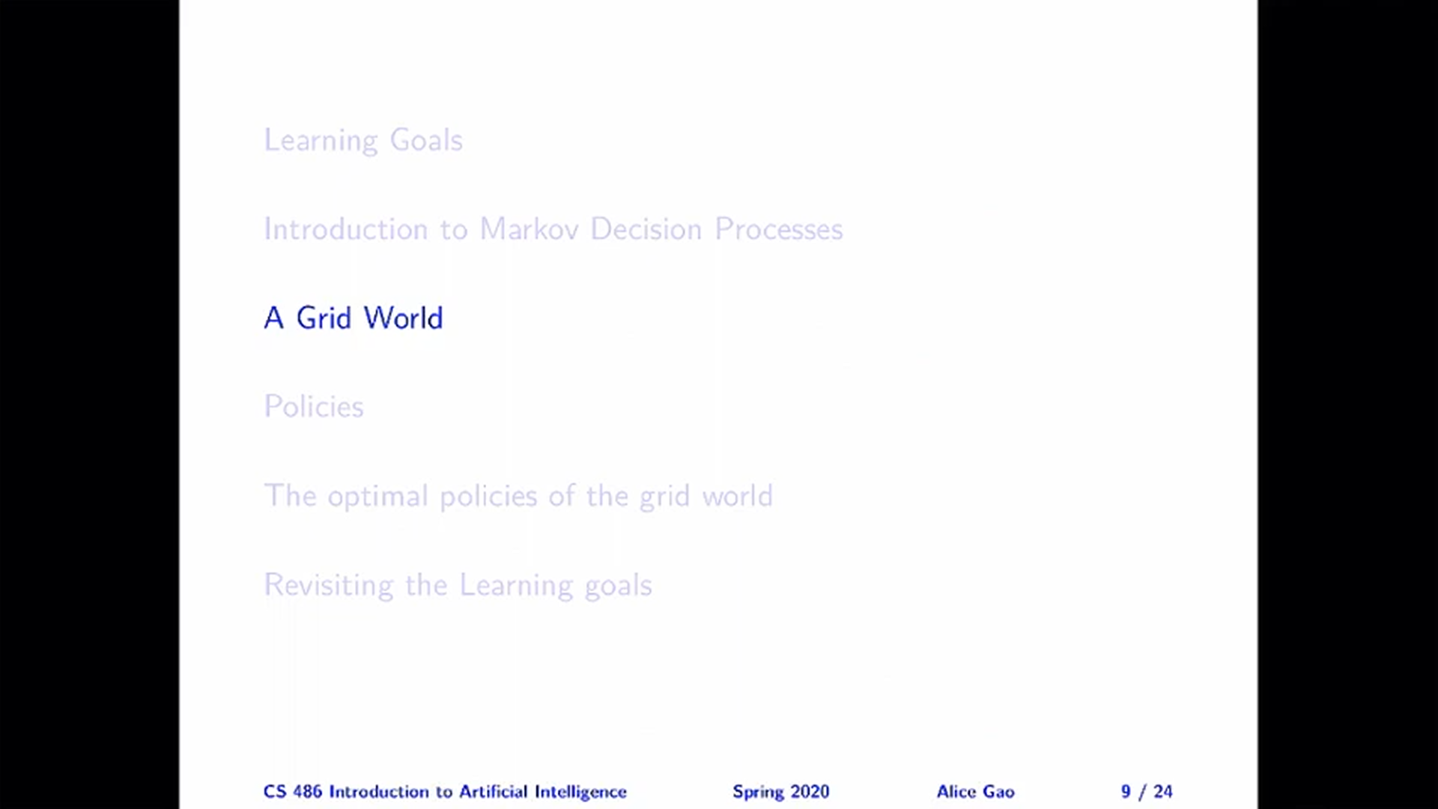

Slide 3
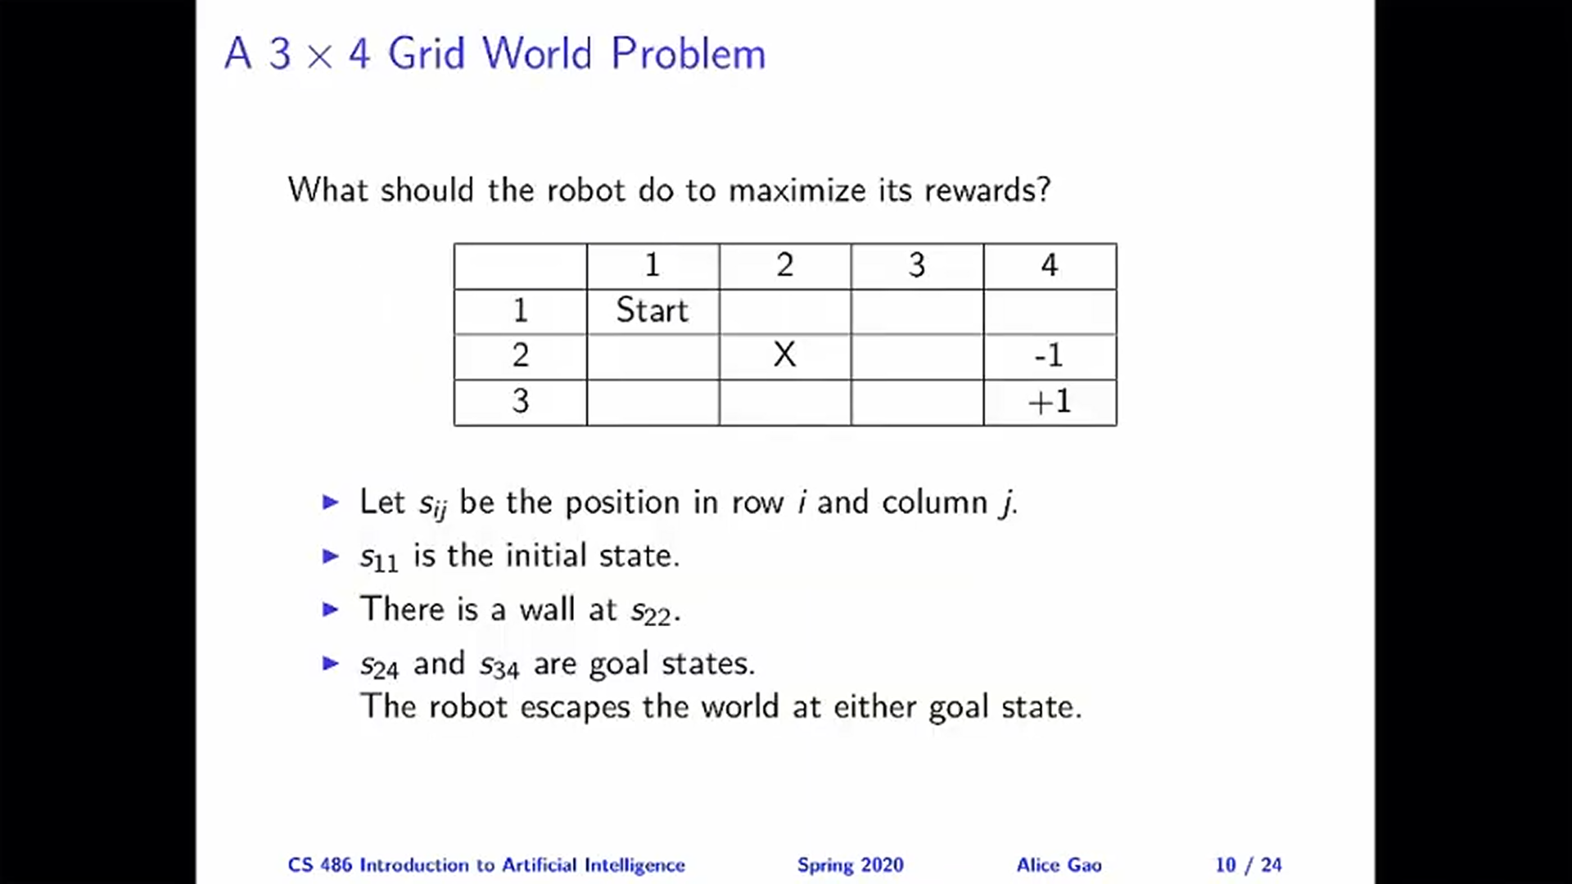

Slide 4
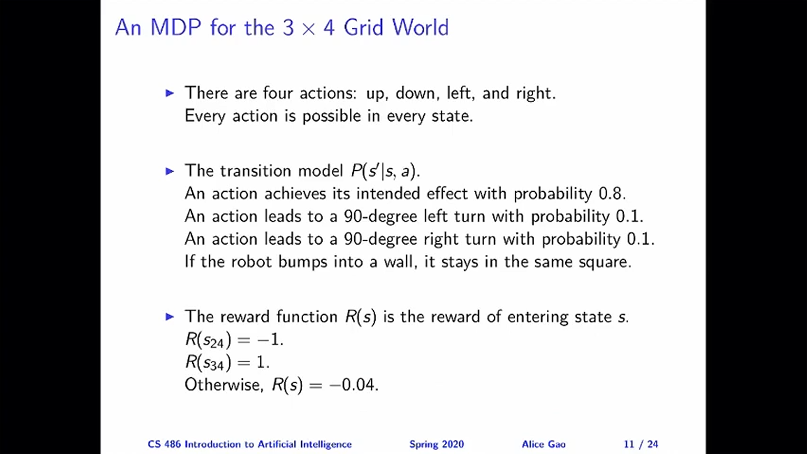

Slide 5
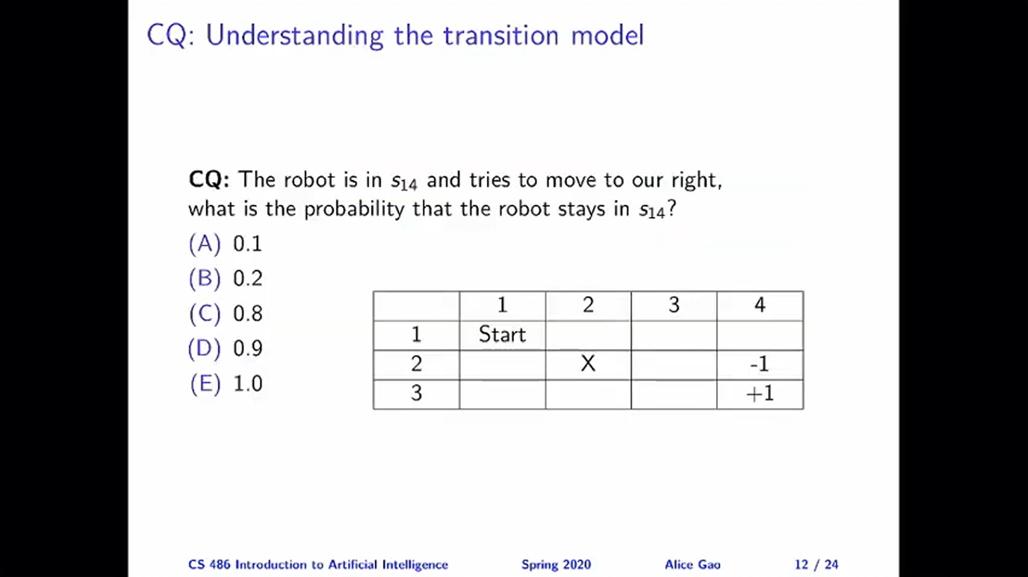

Slide 6
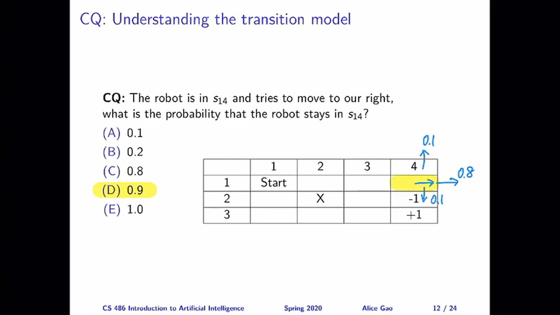

Slide 7
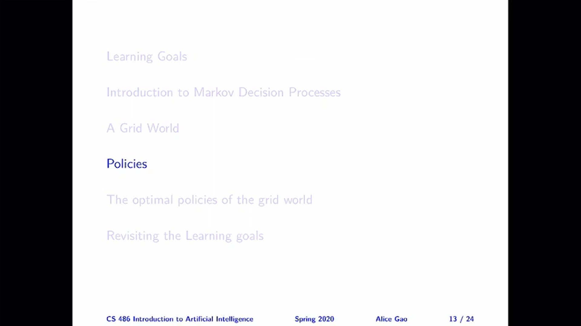

Slide 8
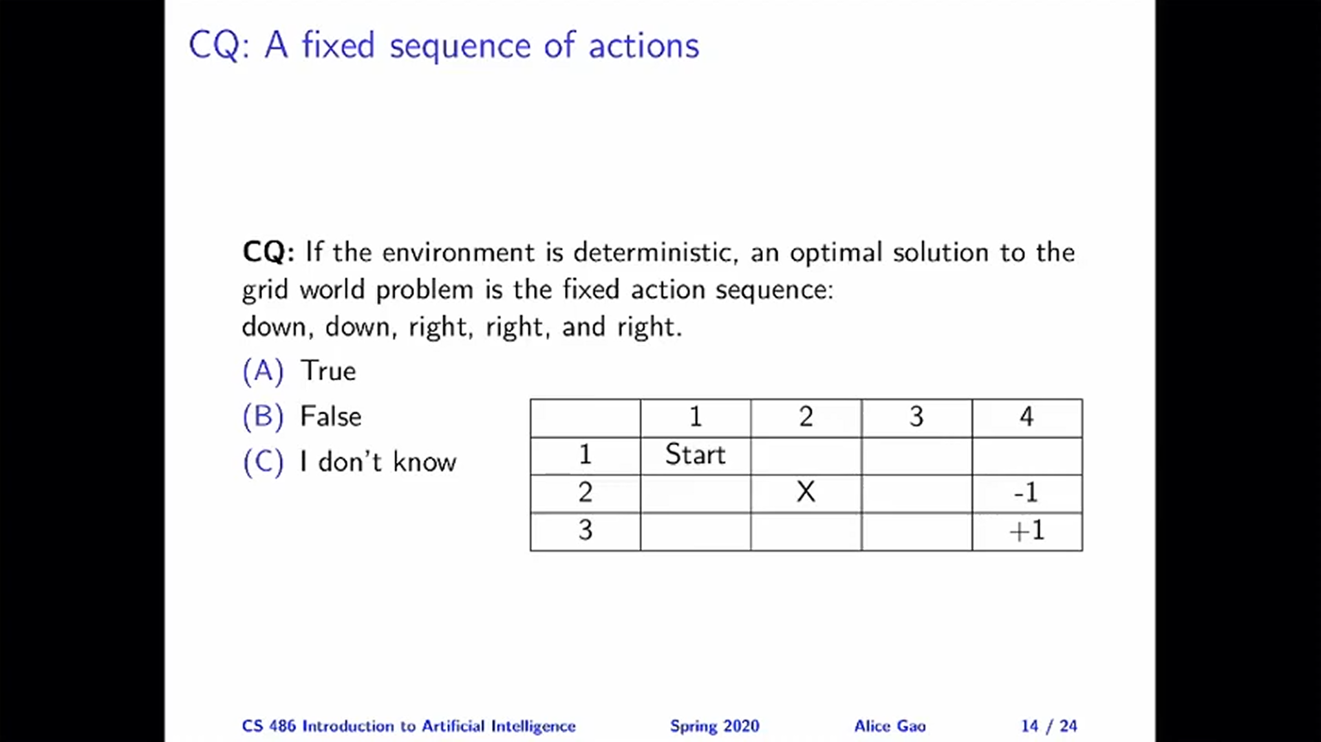

Slide 9
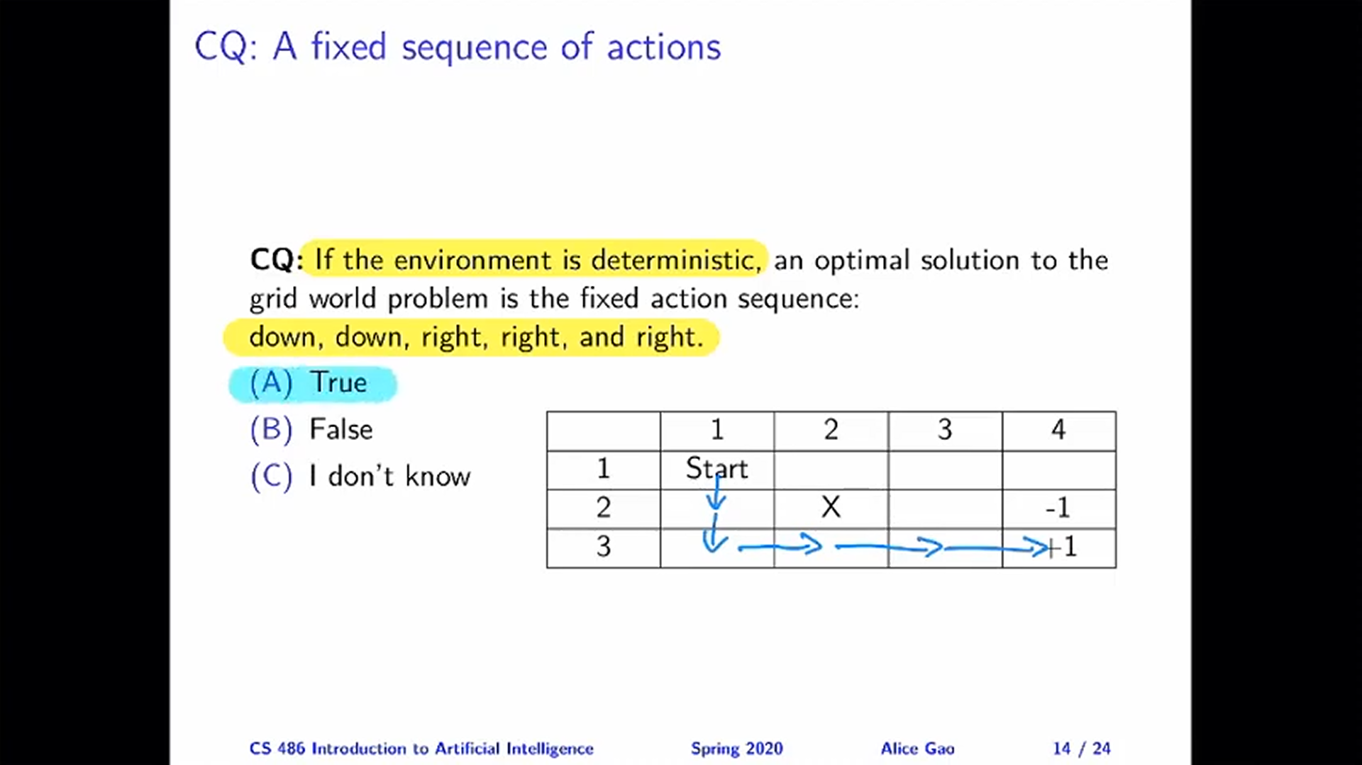

Slide 10
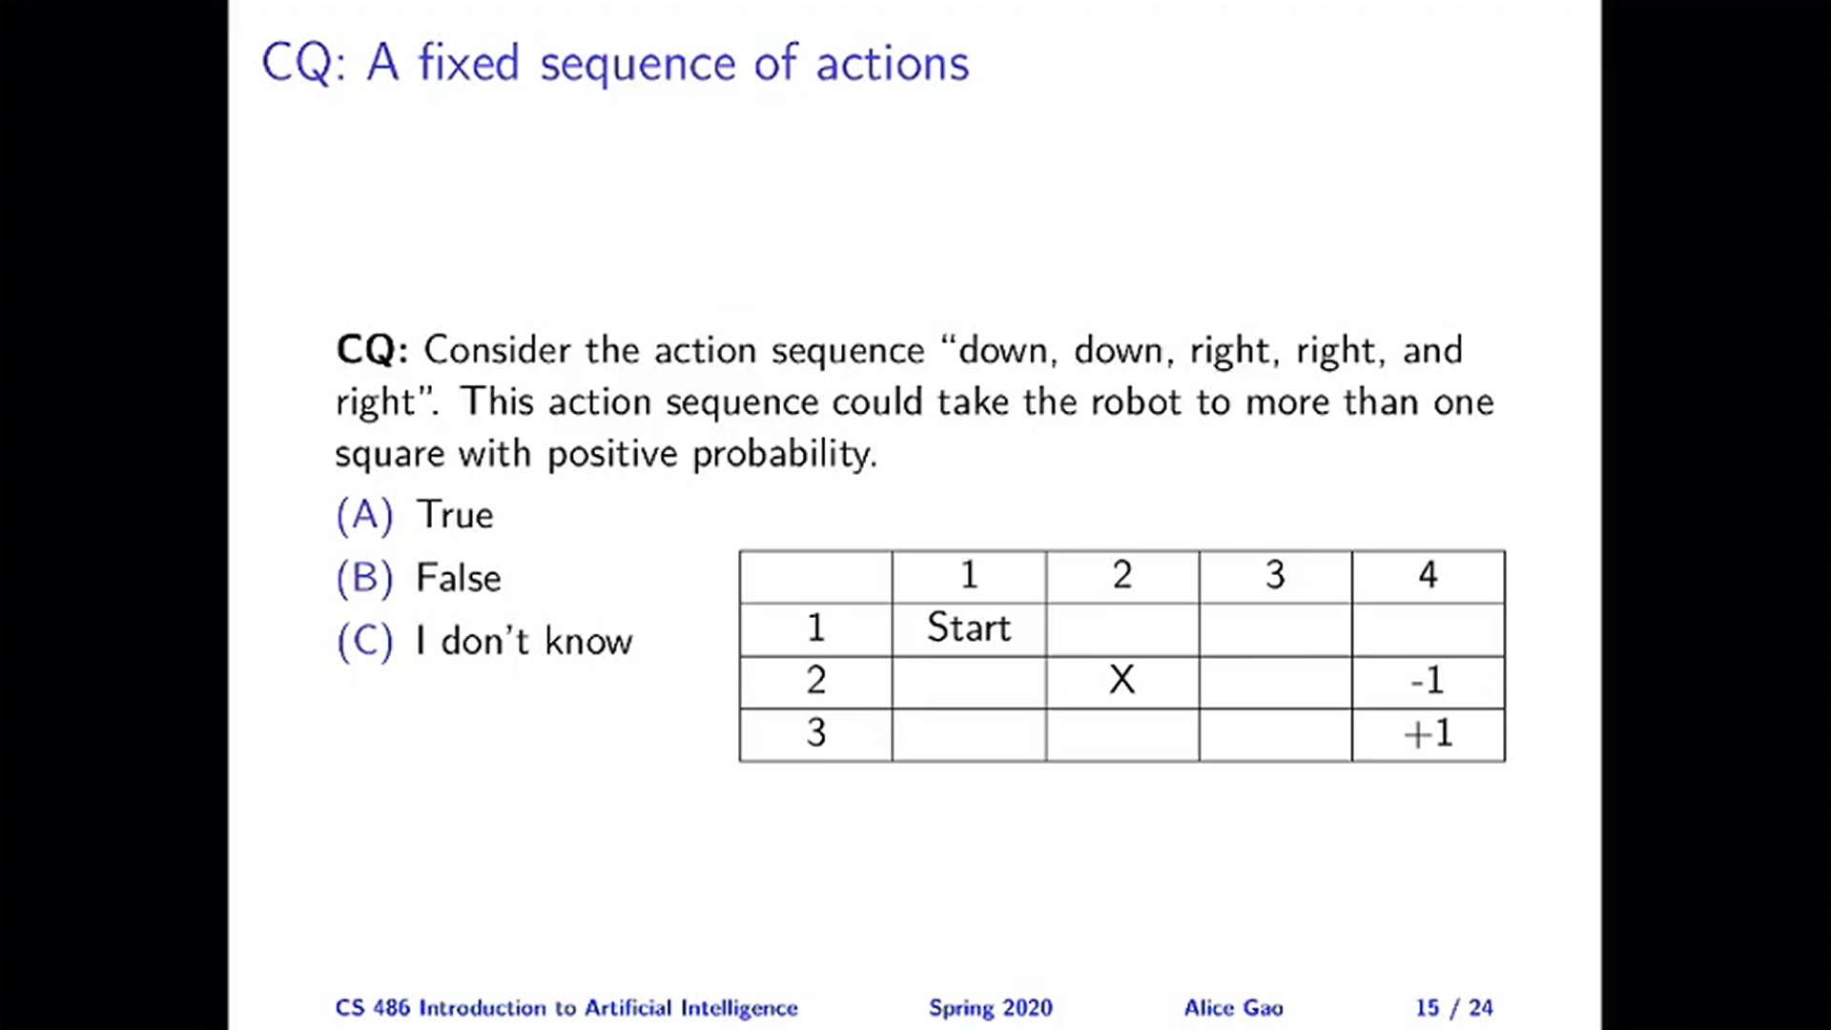

Slide 11
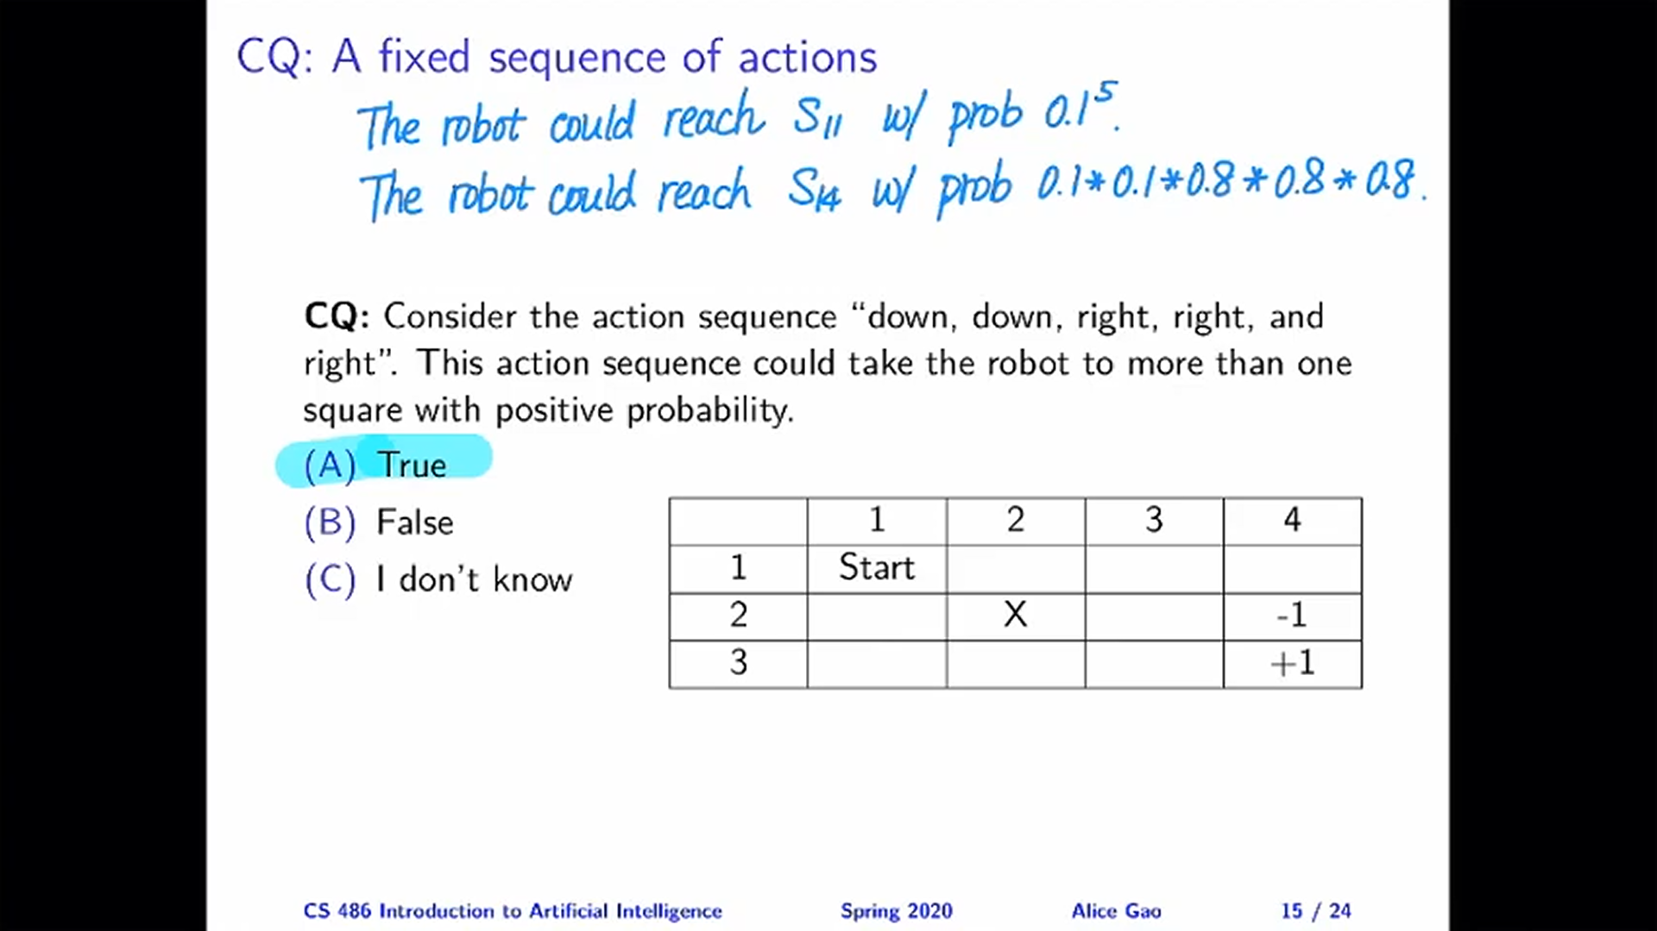

Slide 12
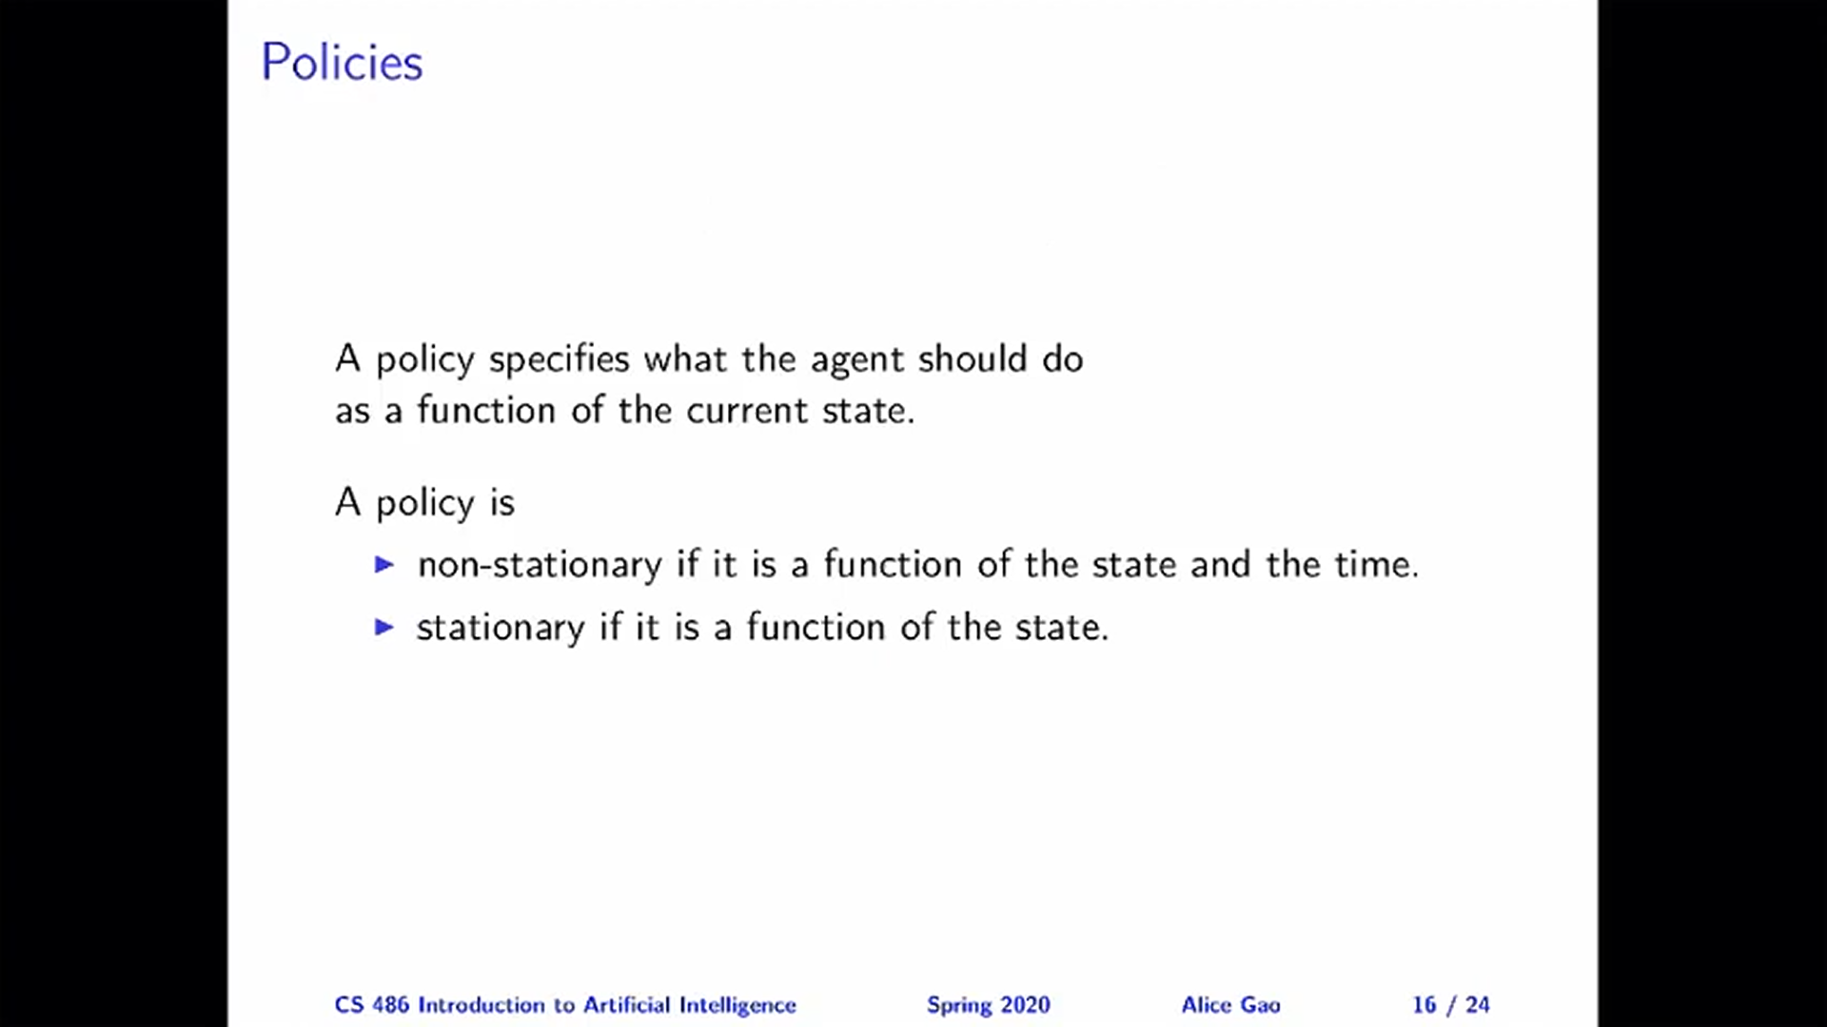

Slide 13
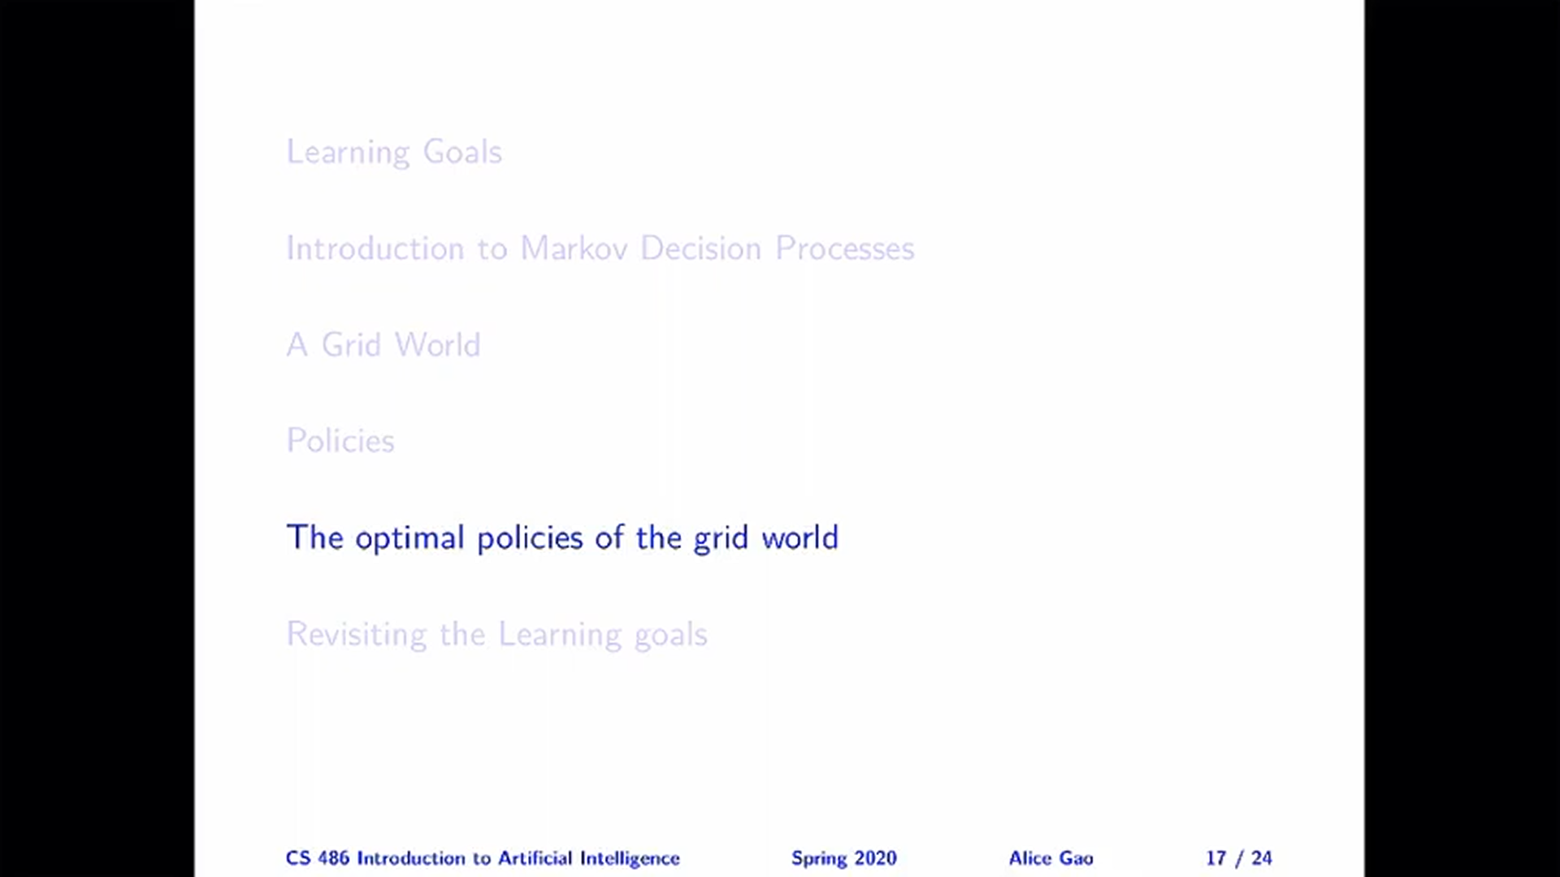

Slide 14
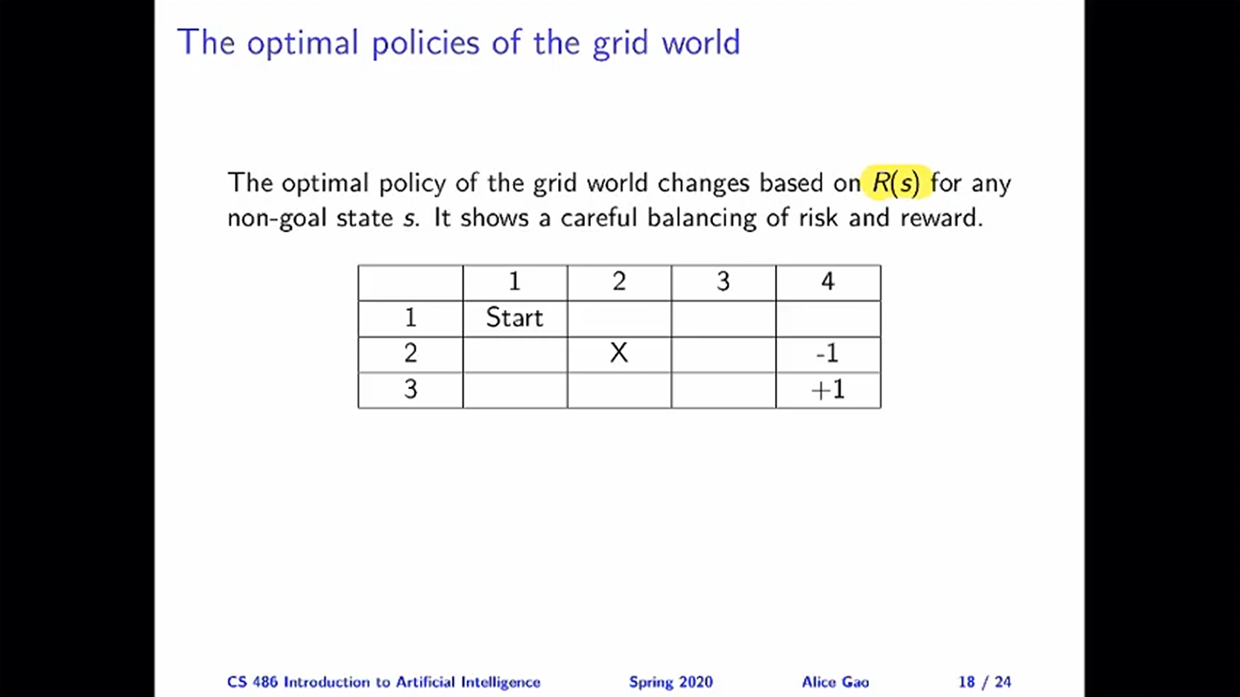

Slide 15
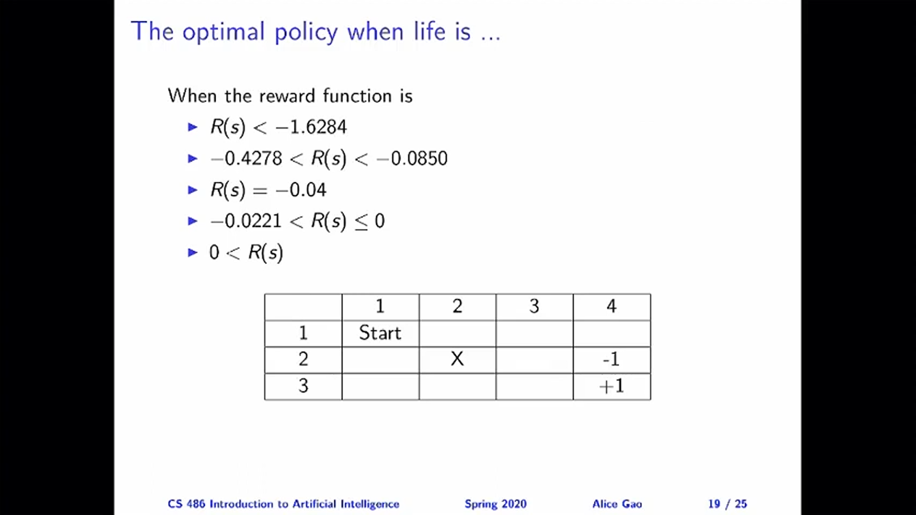

Slide 16
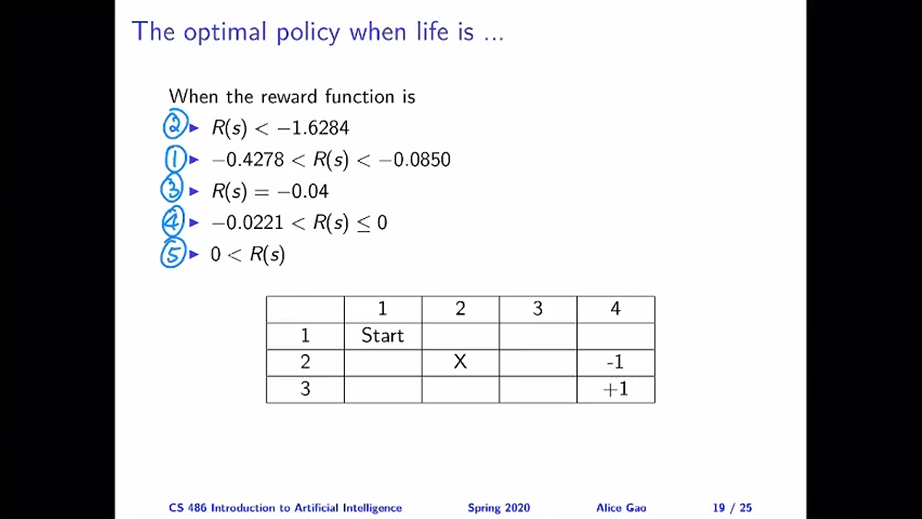

Slide 17
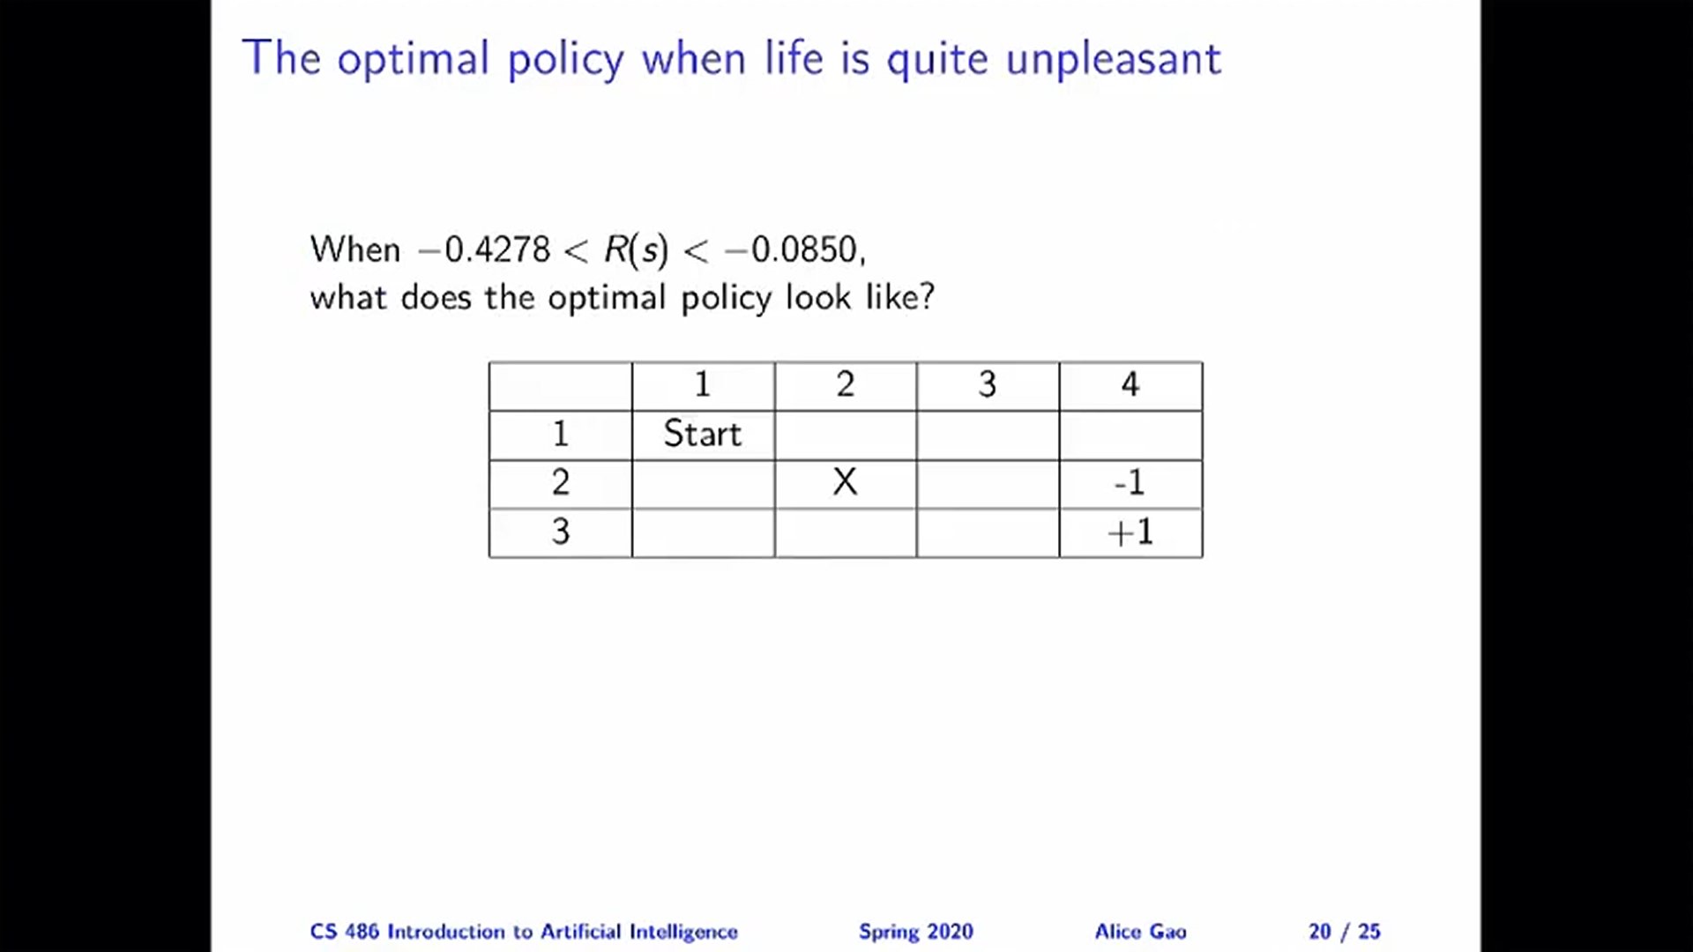

Slide 18
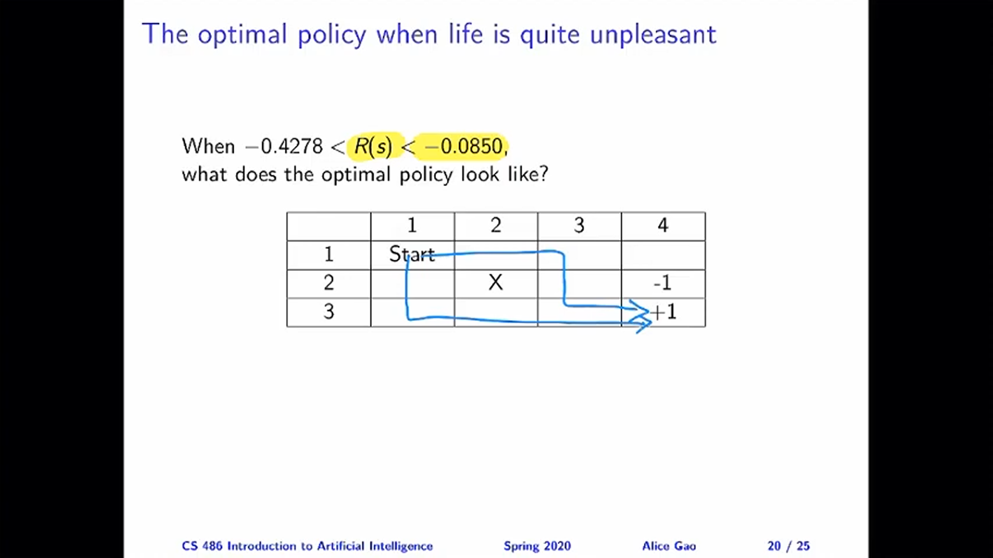

Slide 19
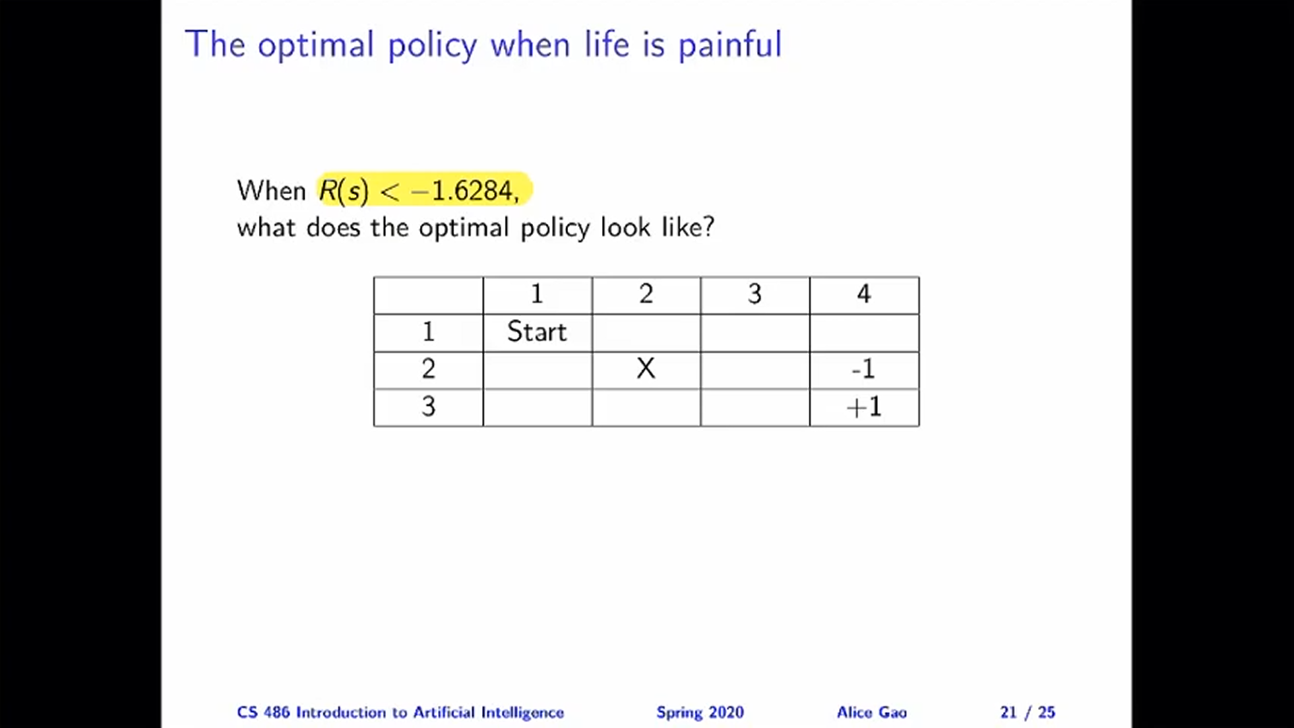

Slide 20
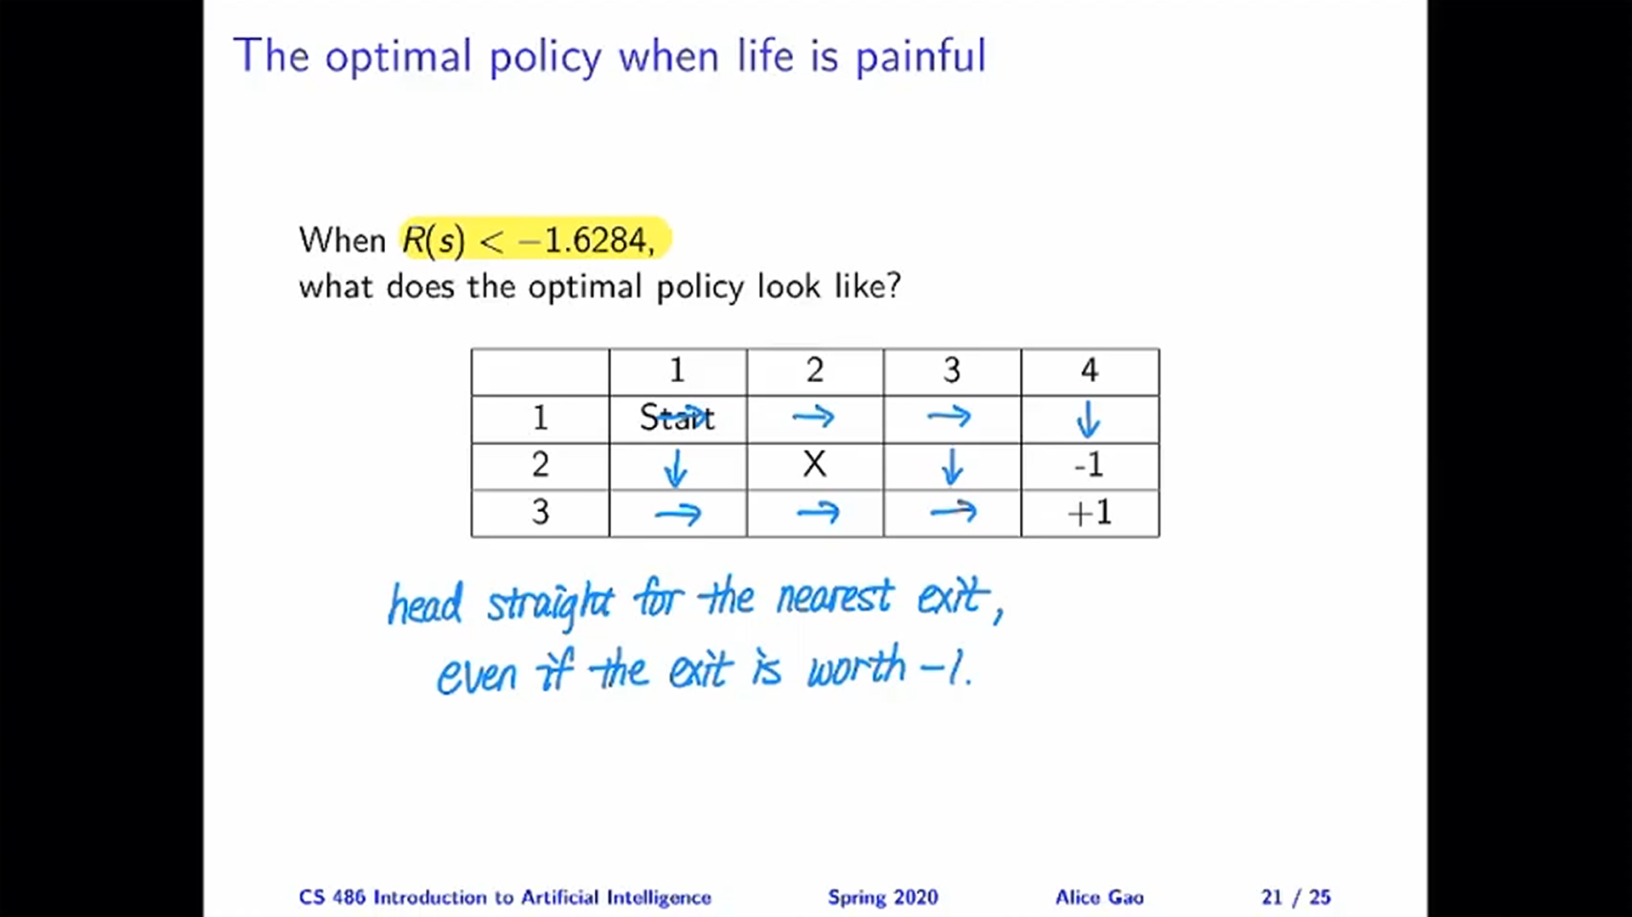

Slide 21
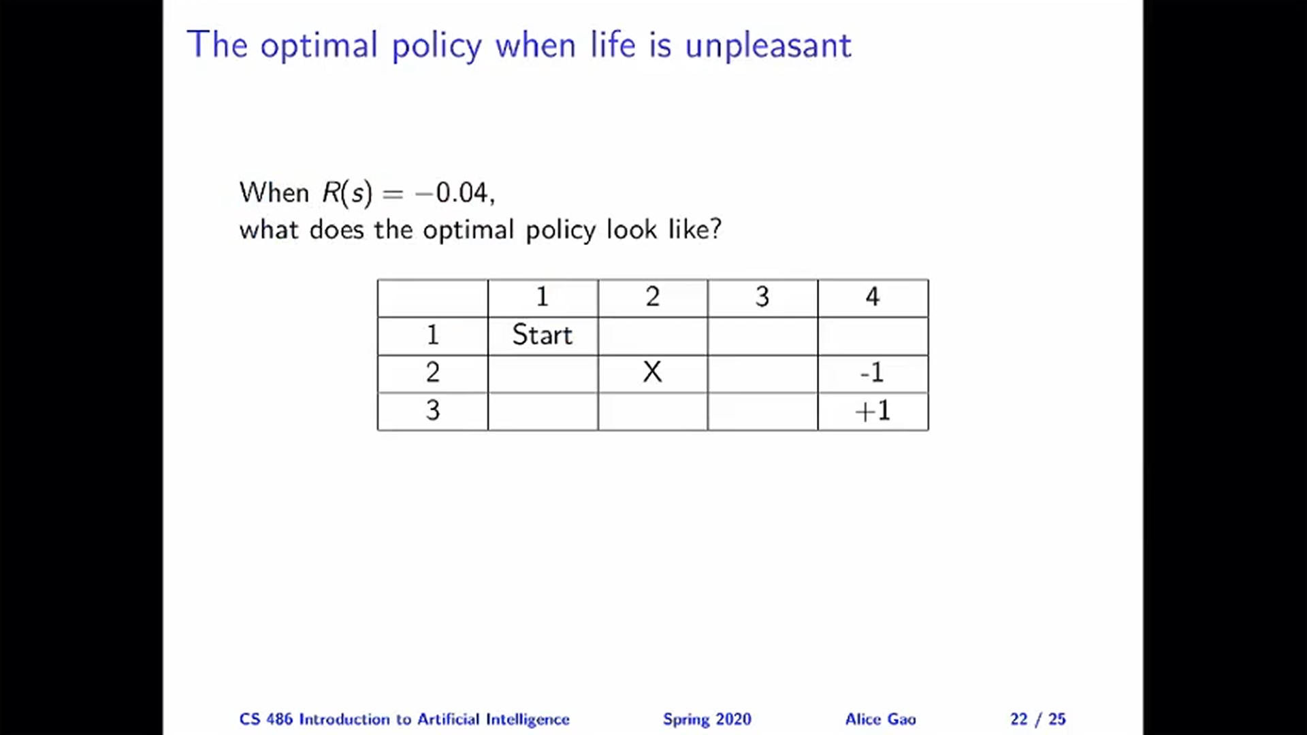

Slide 22
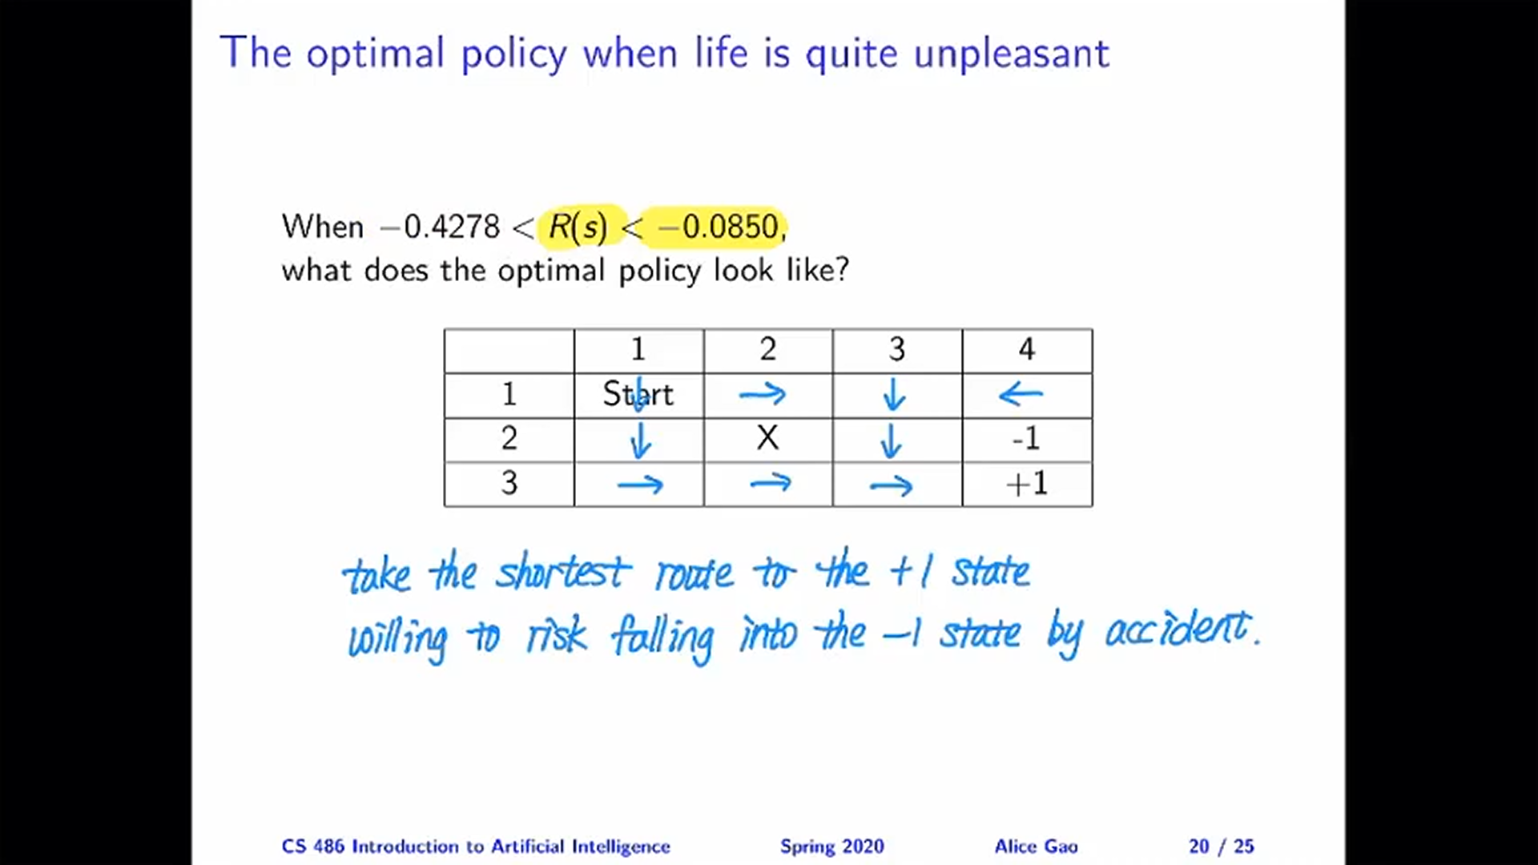

Slide 23
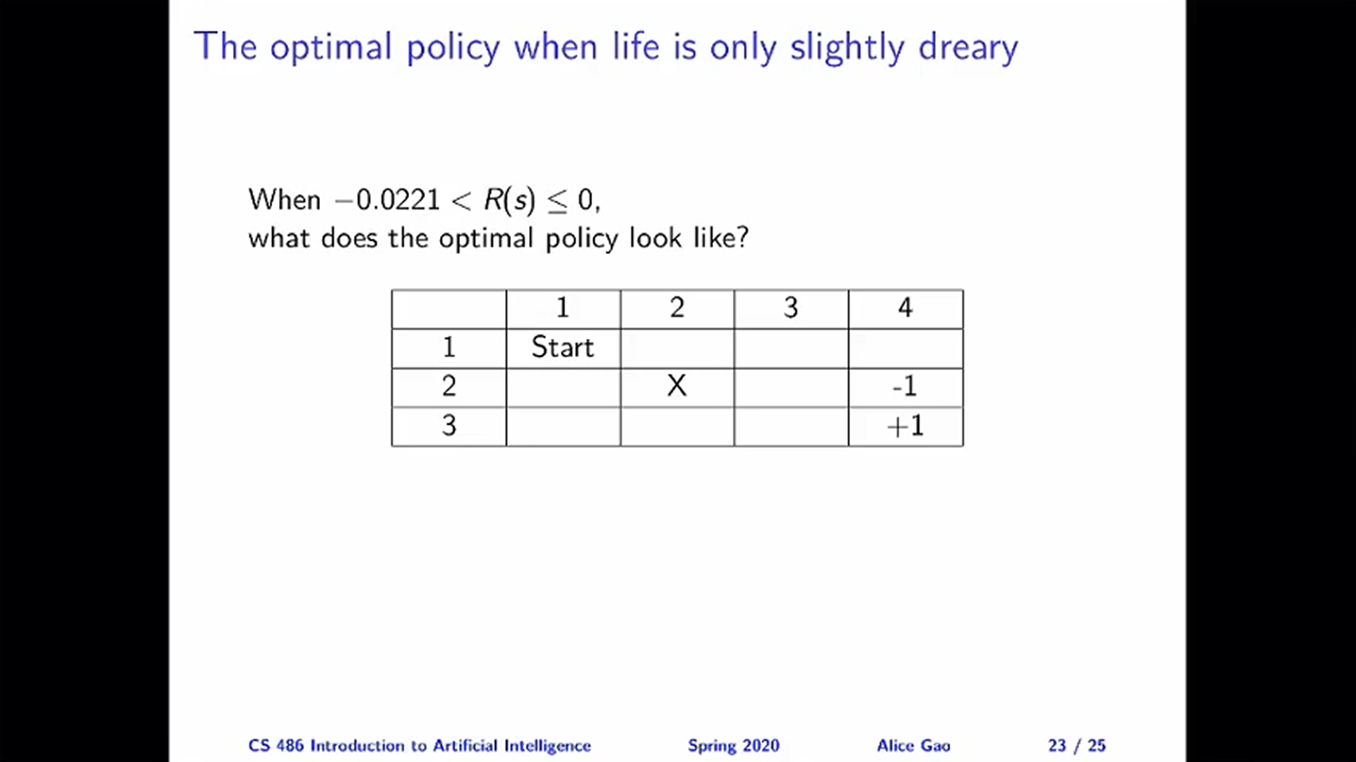

Slide 24
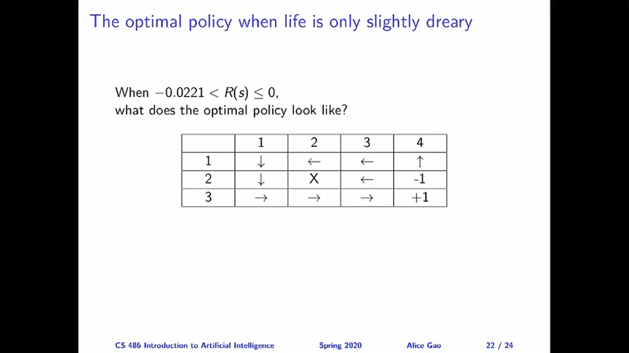

Slide 25
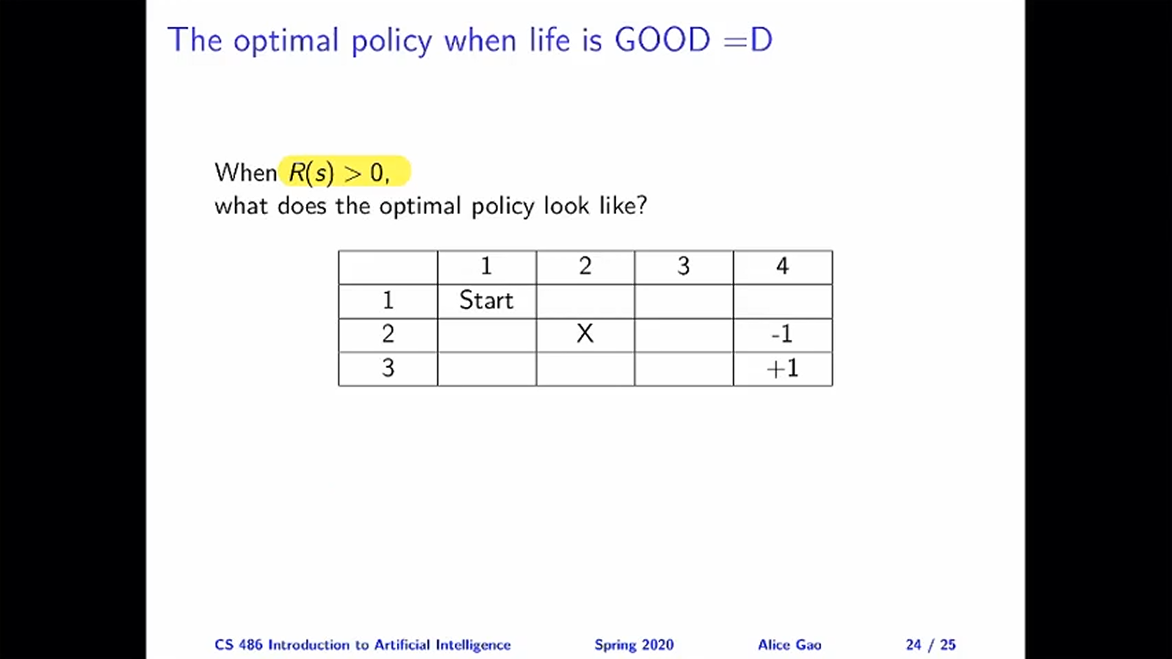

Slide 26
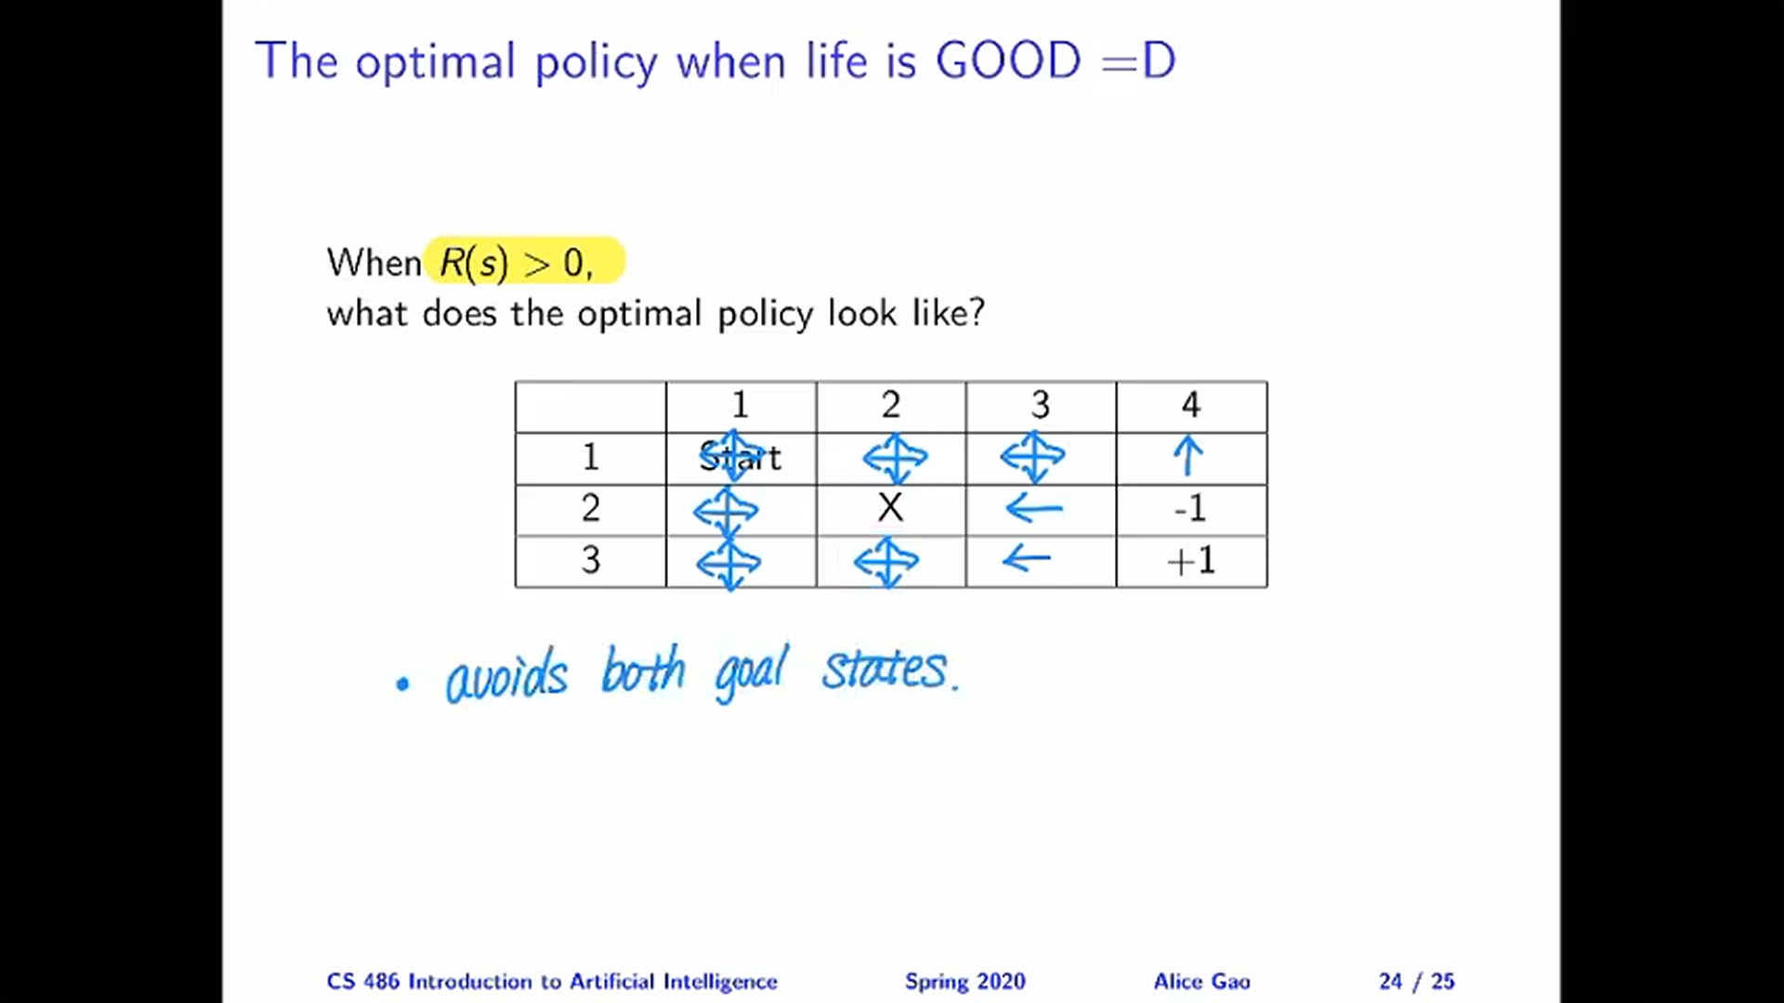

Slide 27
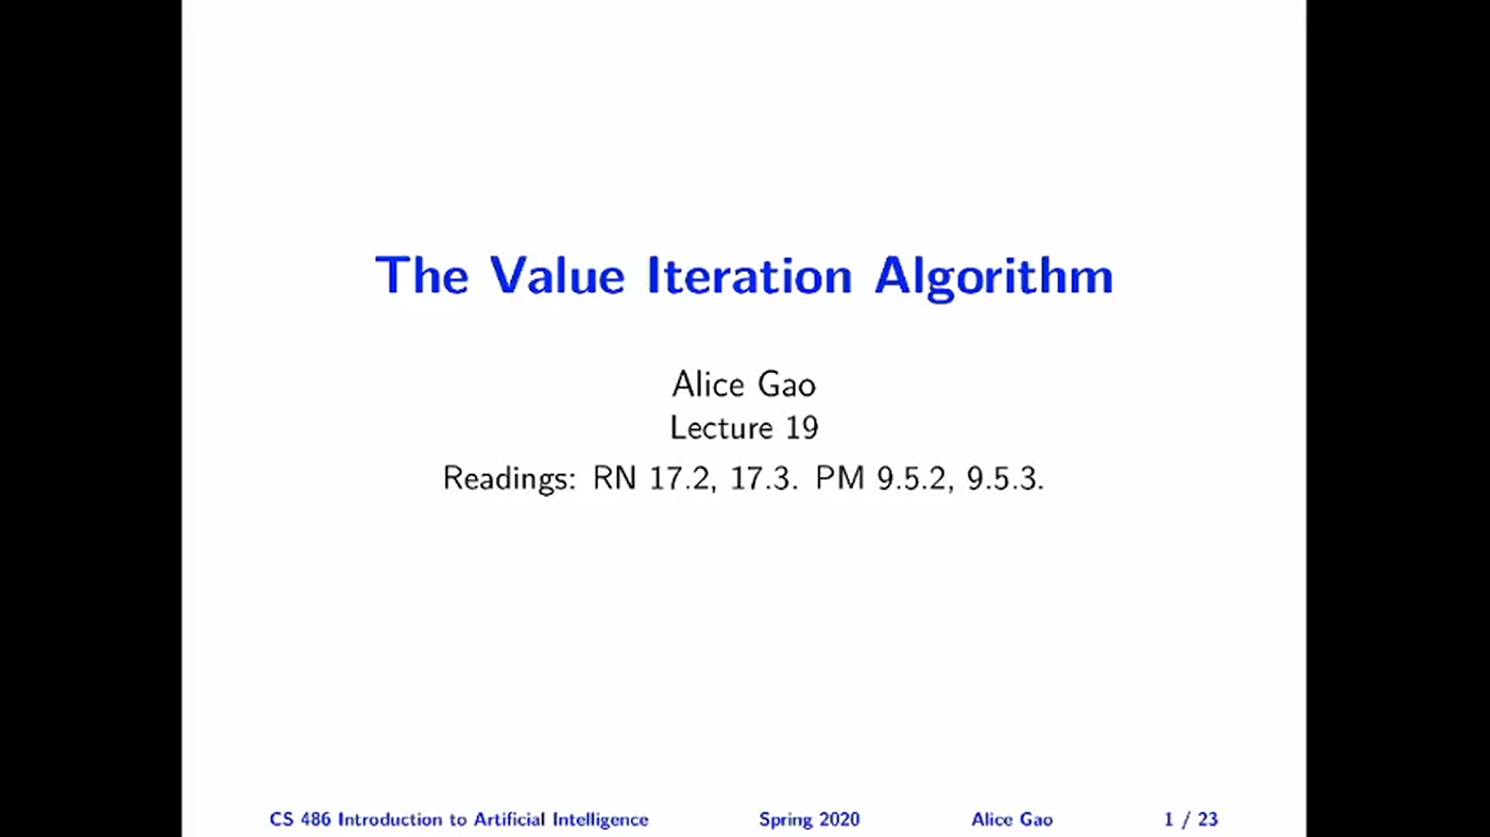

Slide 28
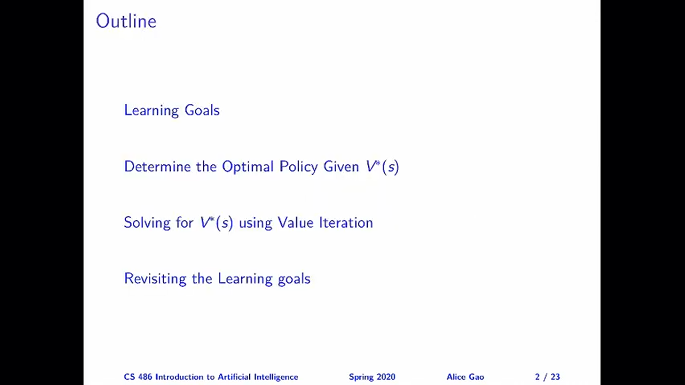

Slide 29
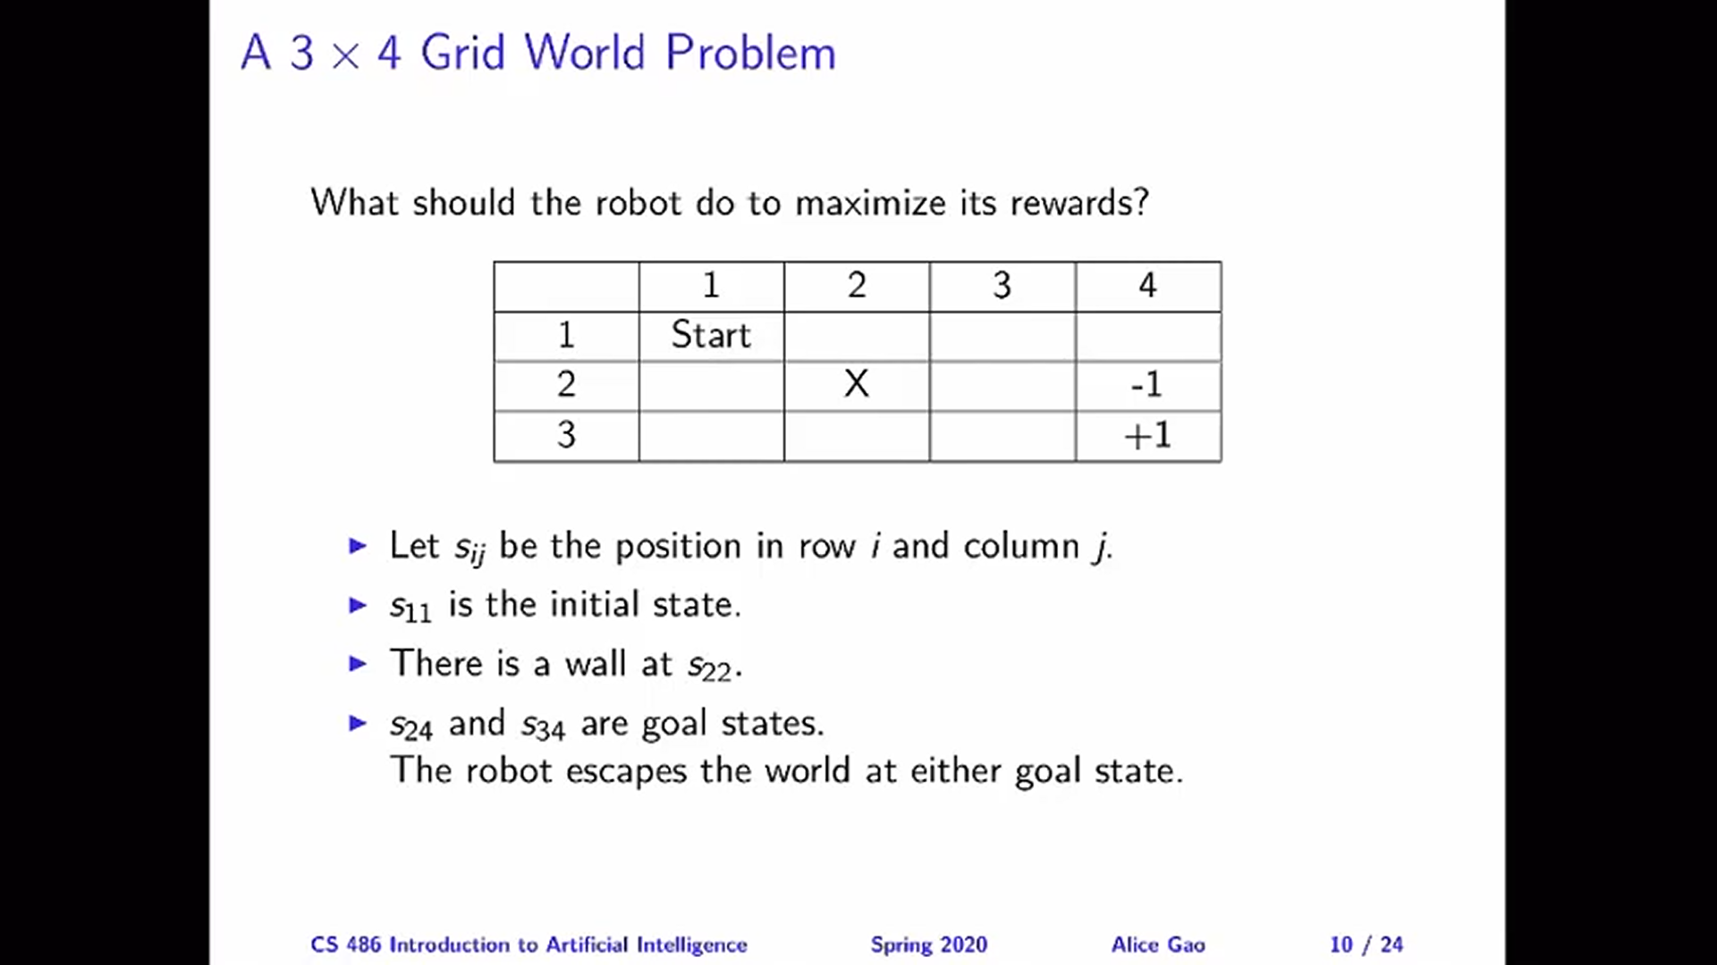

Slide 30
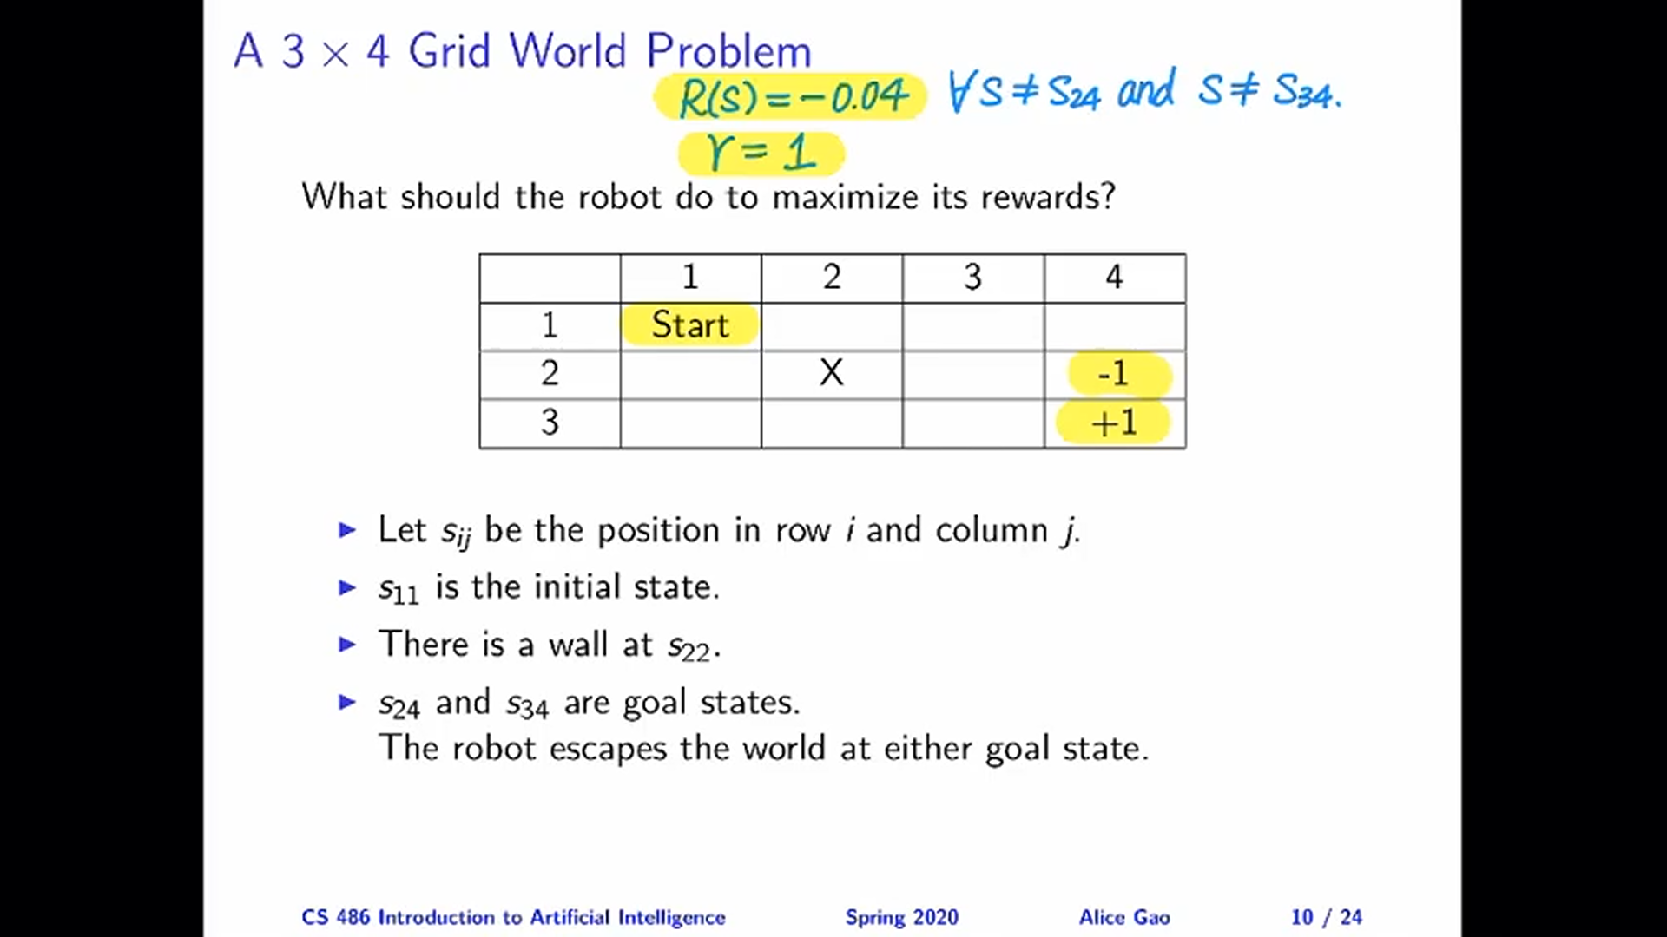

Slide 31
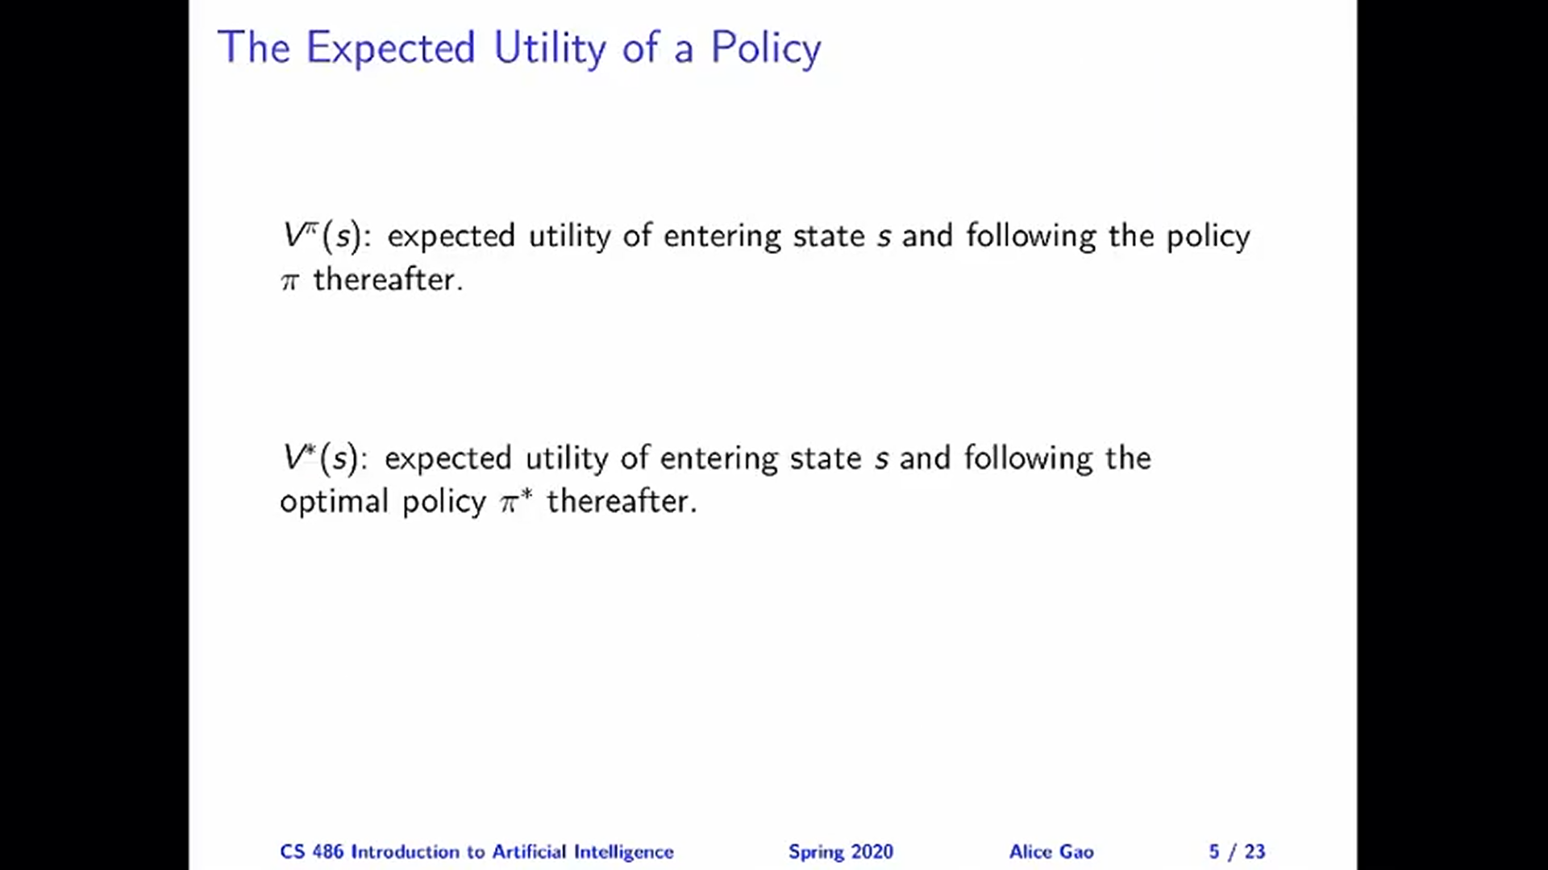

Slide 32
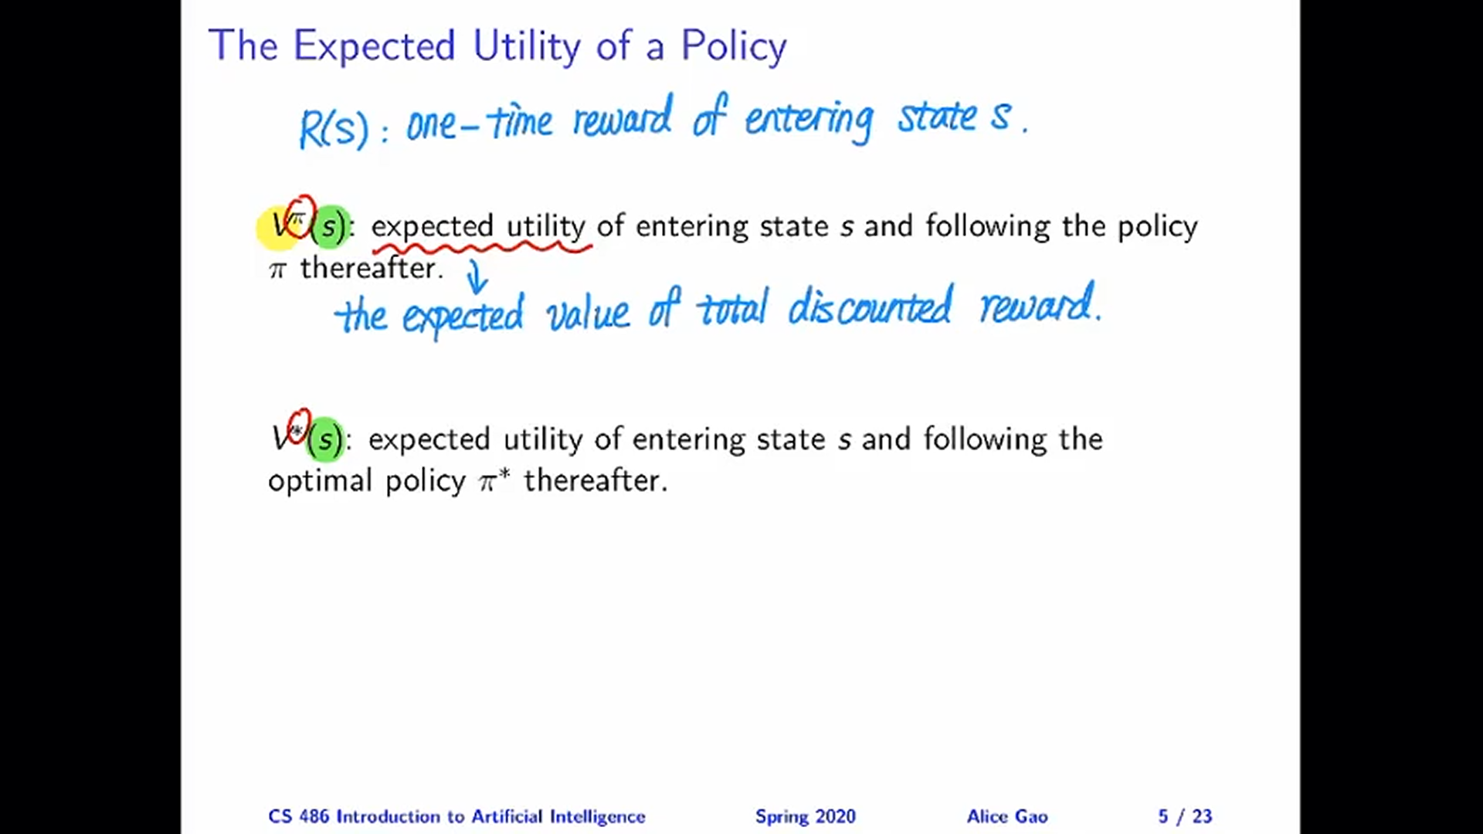

Slide 33
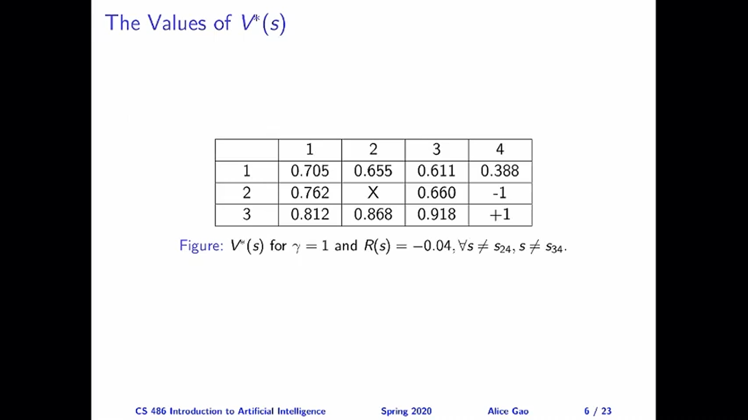

Slide 34
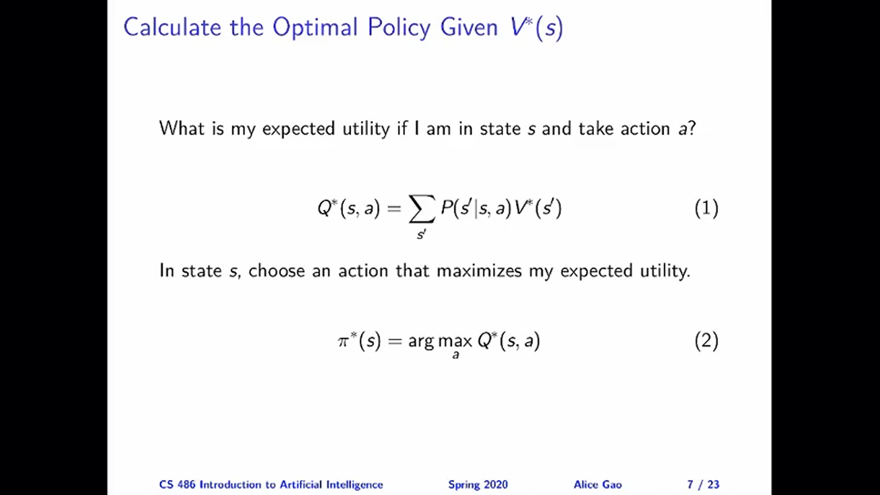

Slide 35
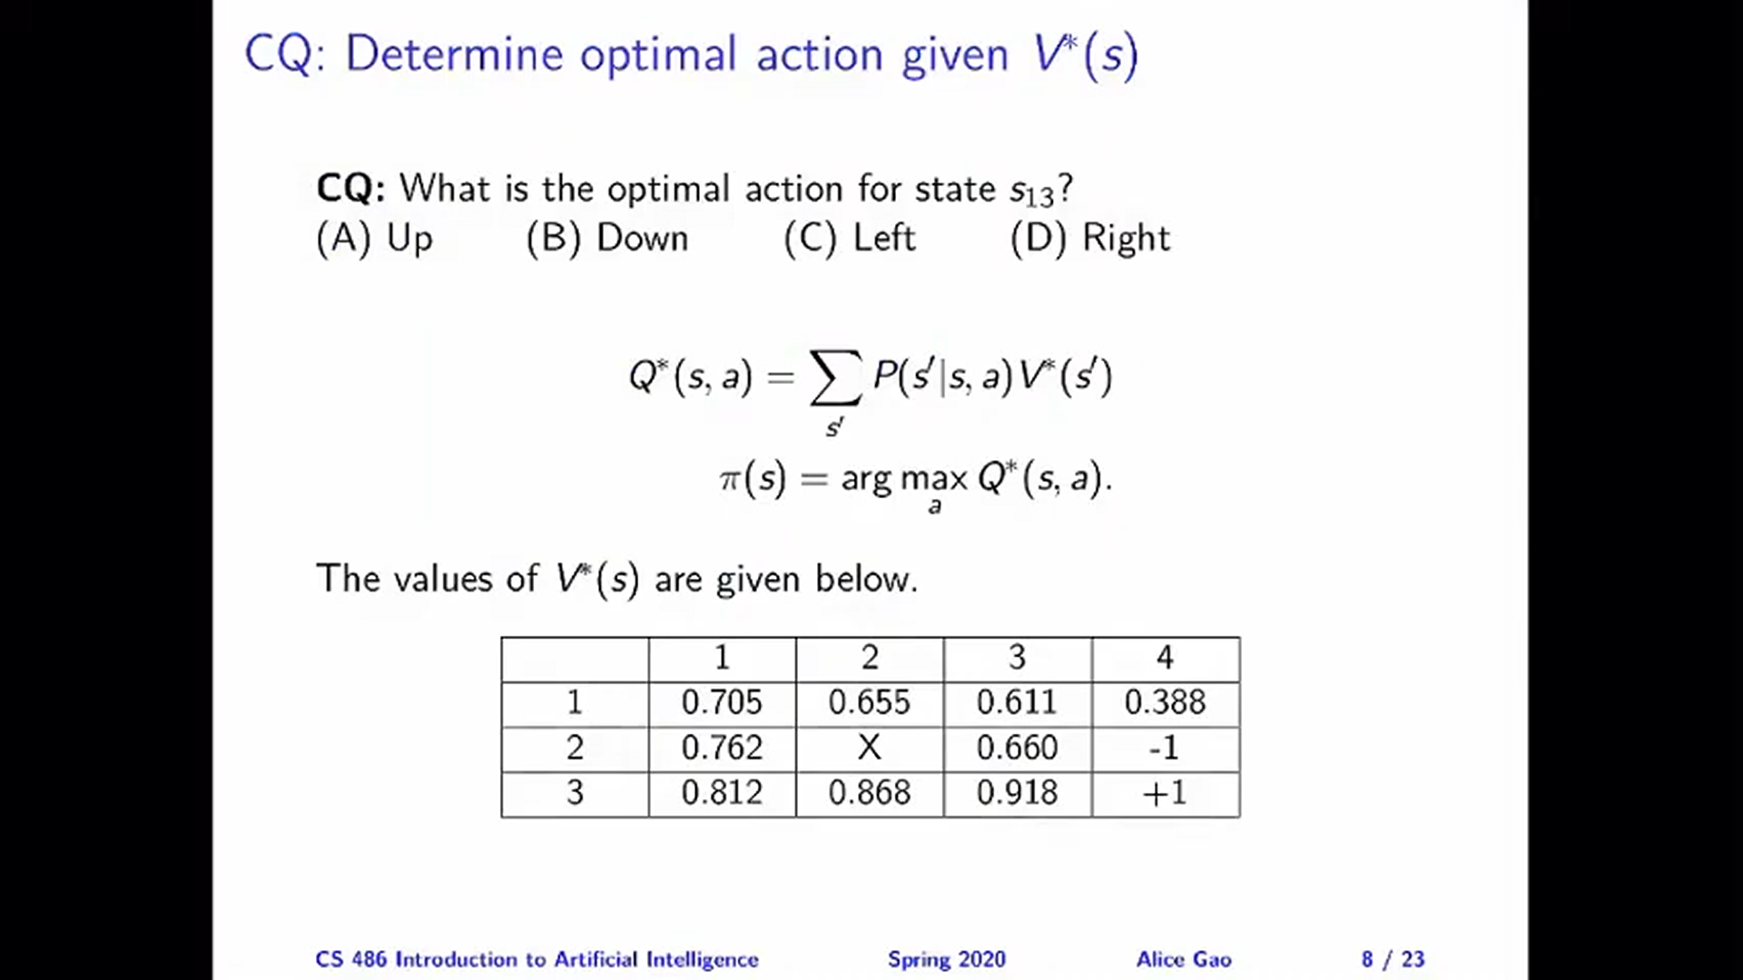

Slide 36
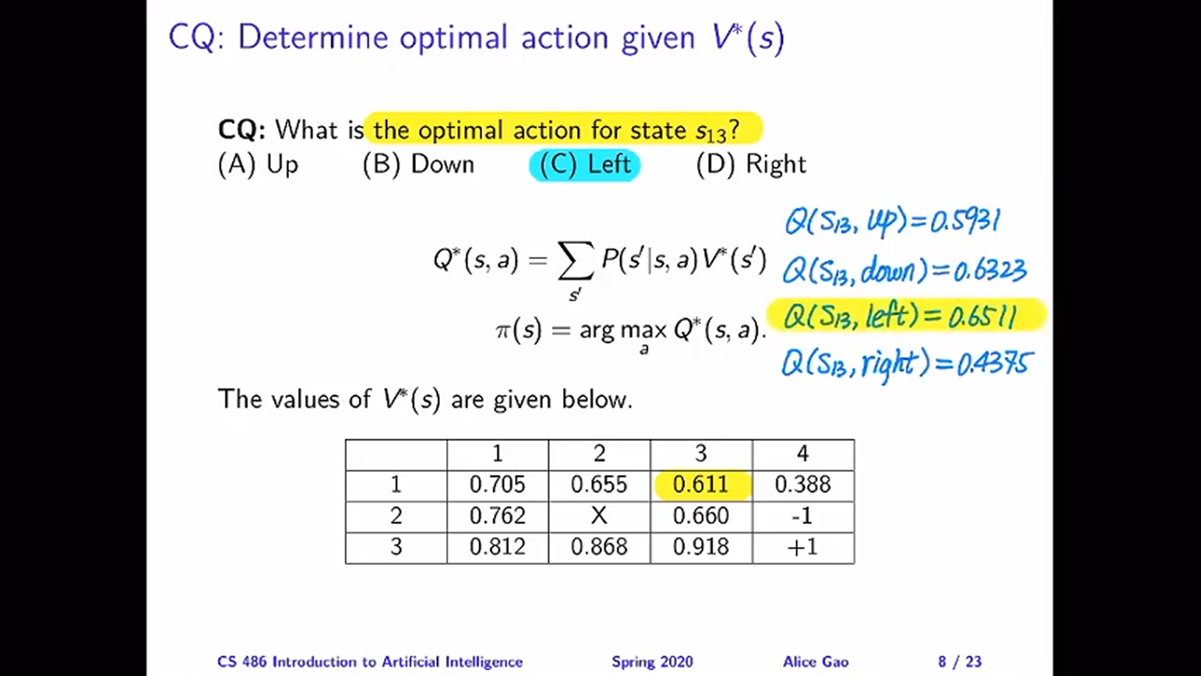

Slide 37
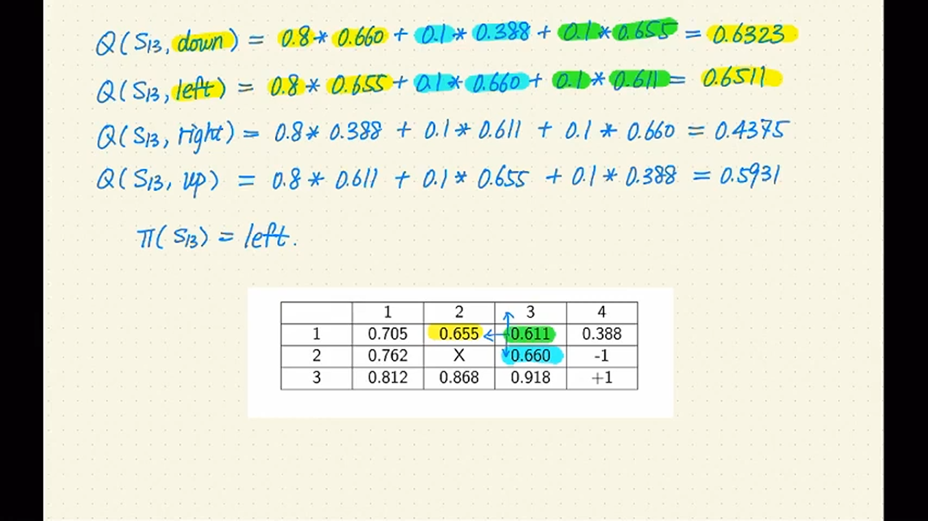

Slide 38
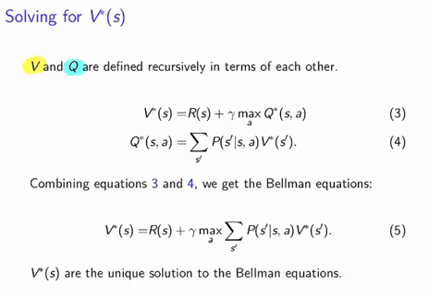
Value Iteration

Slide 39
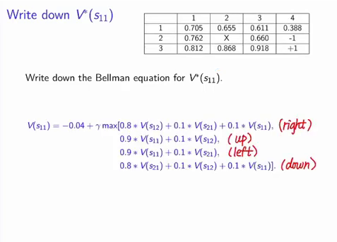
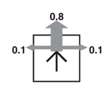
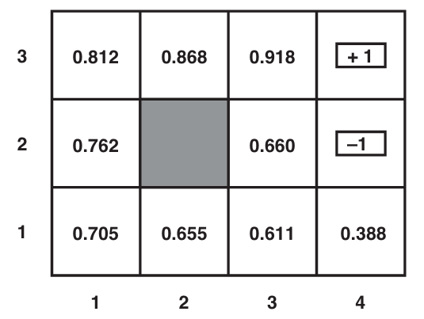
Value Iteration

Slide 40
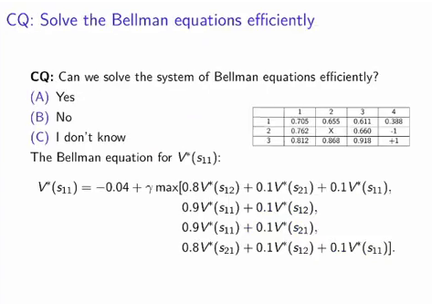
Value Iteration

Slide 41
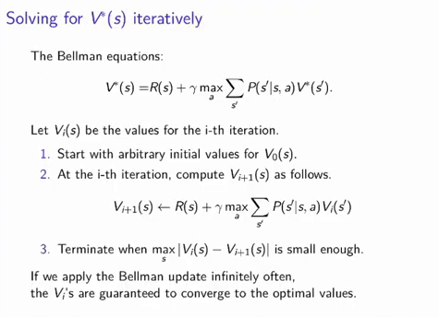
..
Value Iteration

Slide 42
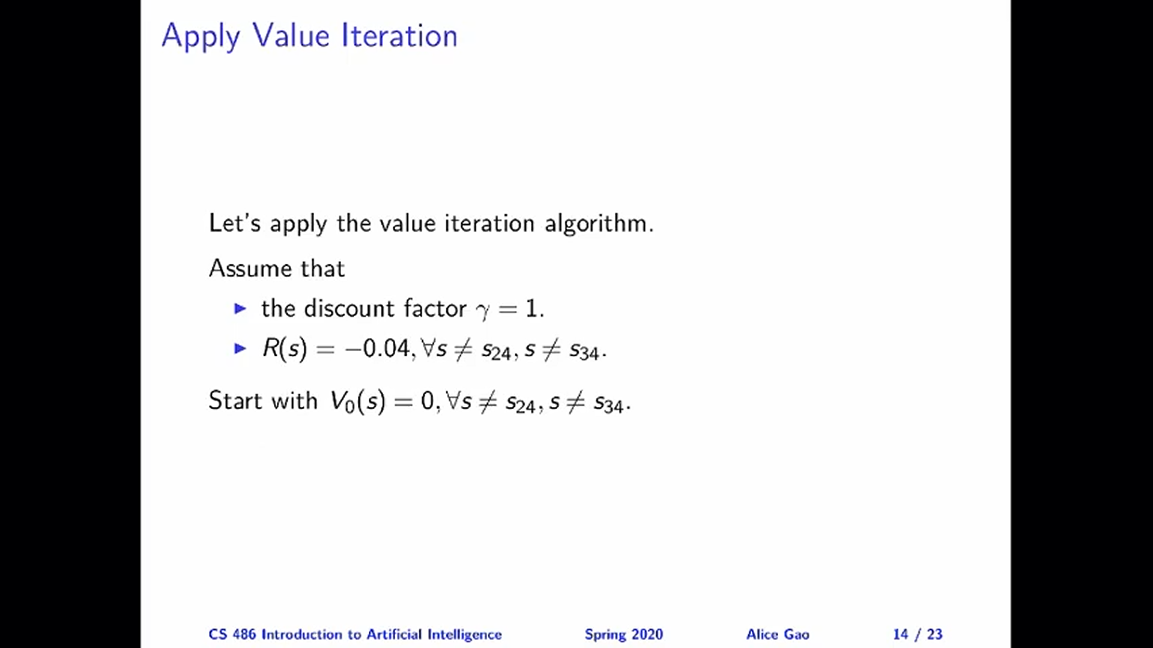

Slide 43
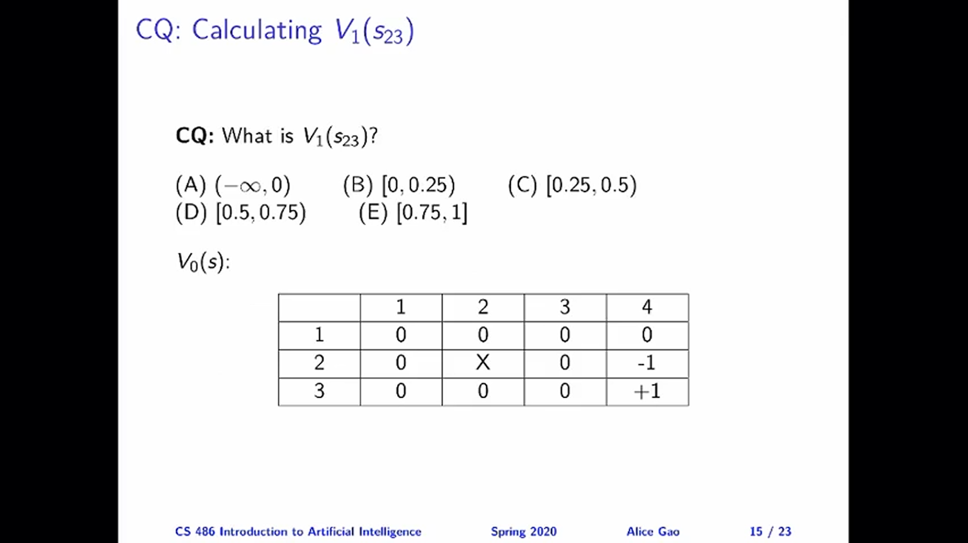

Slide 44
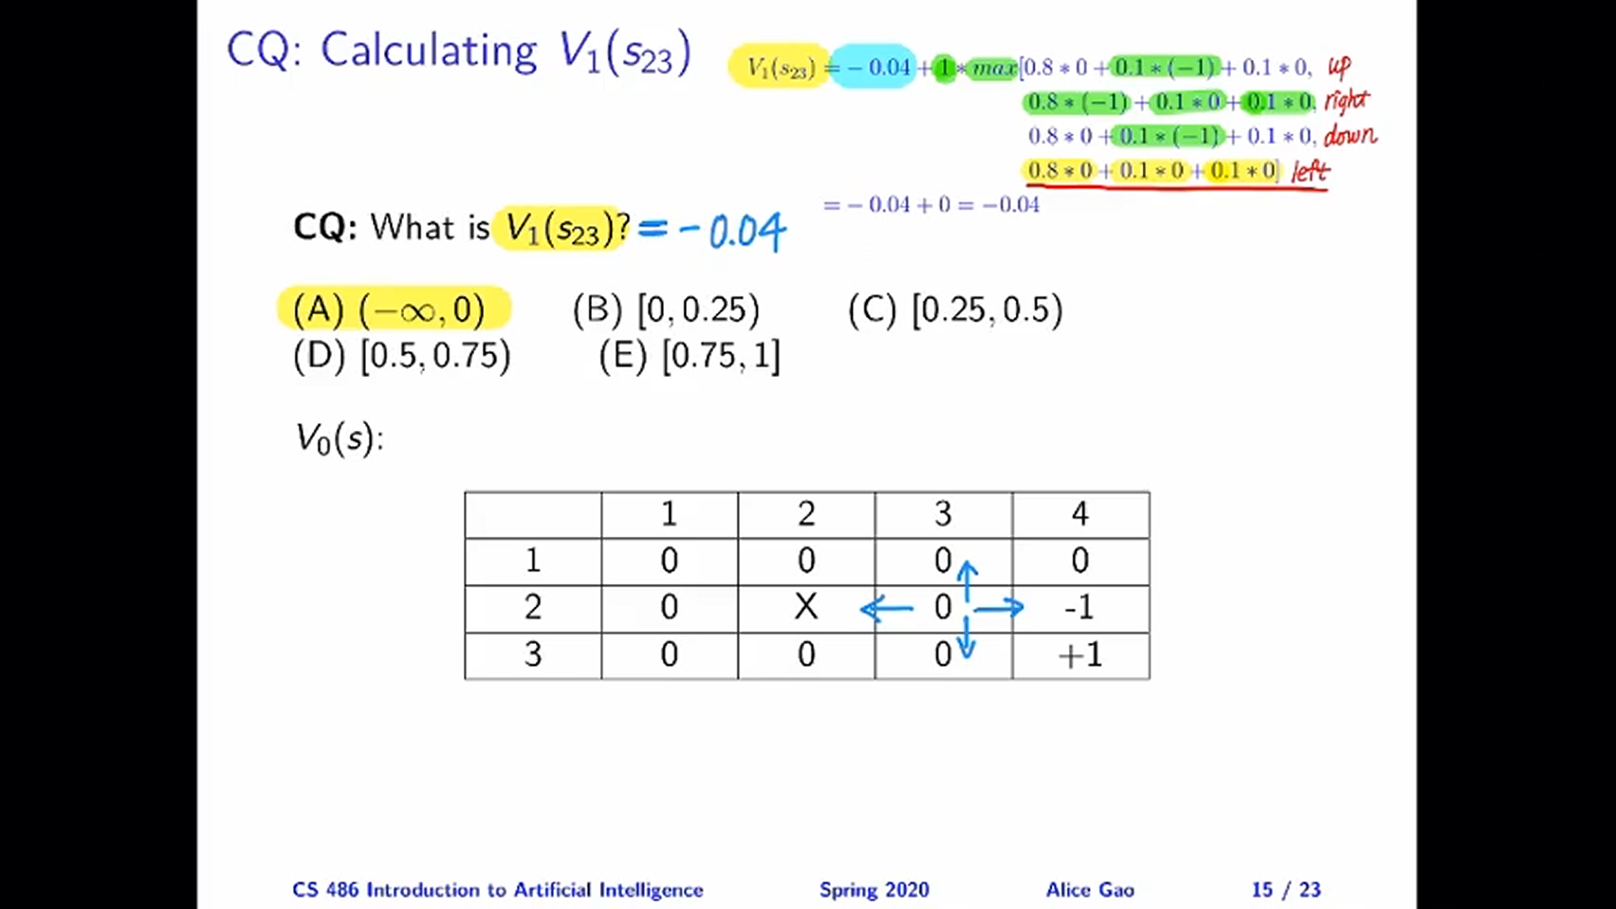

Slide 45
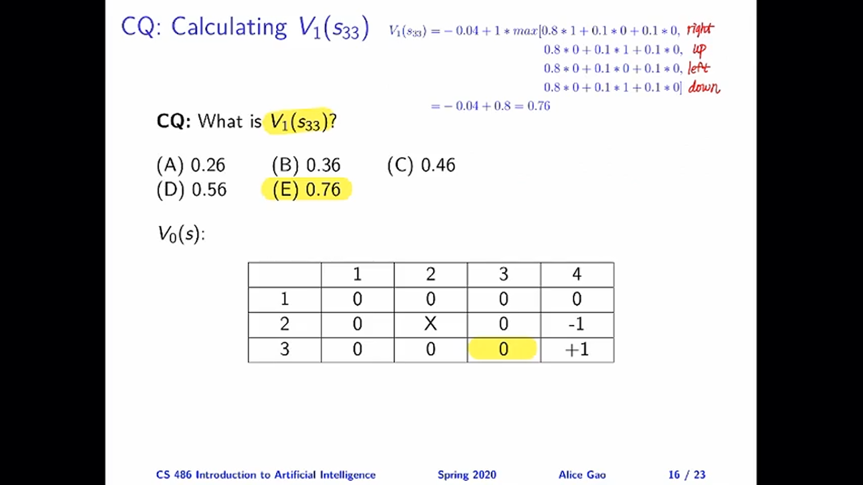

Slide 46
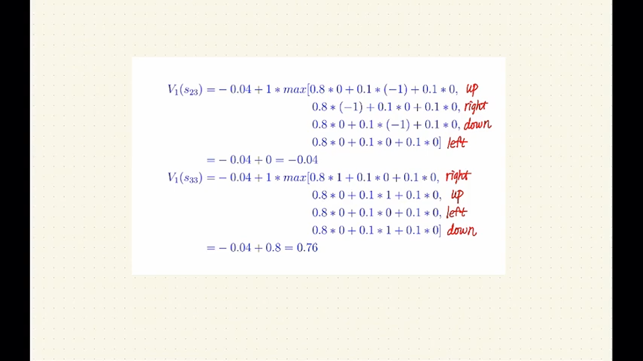

Slide 47
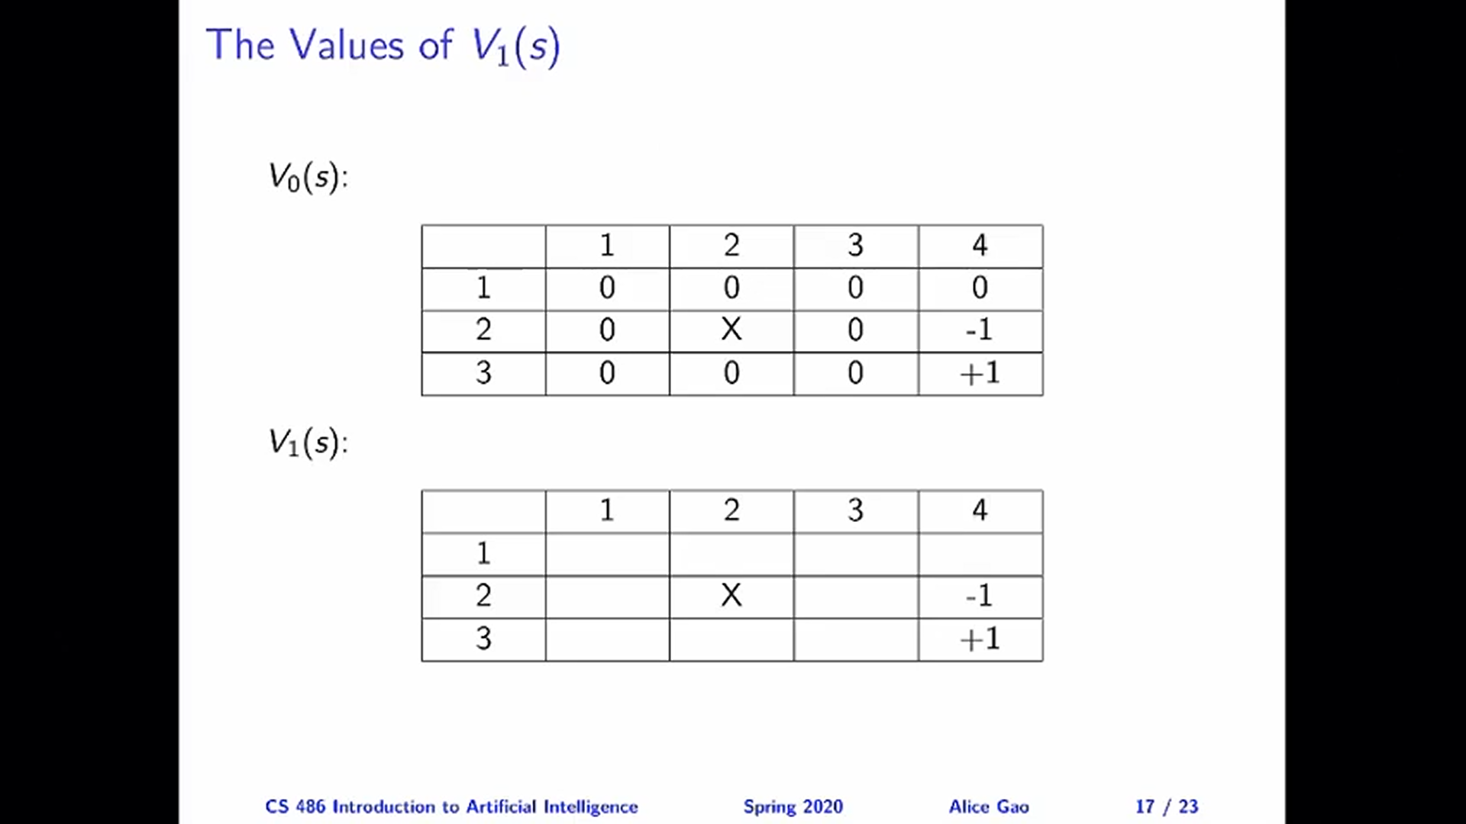

Slide 48
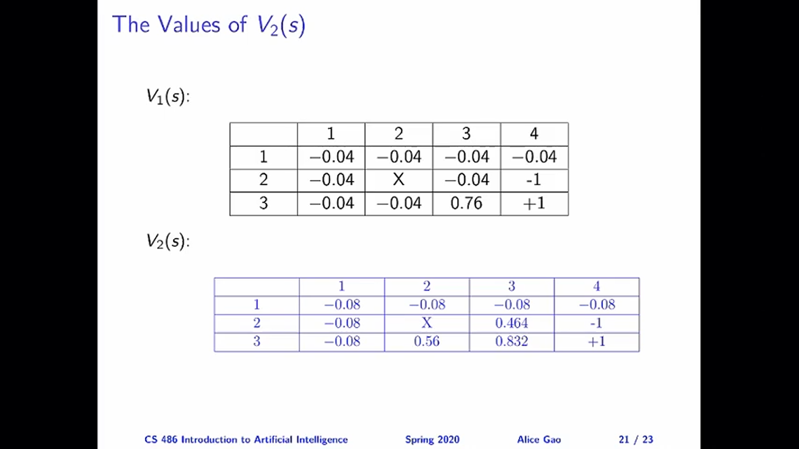

Slide 49
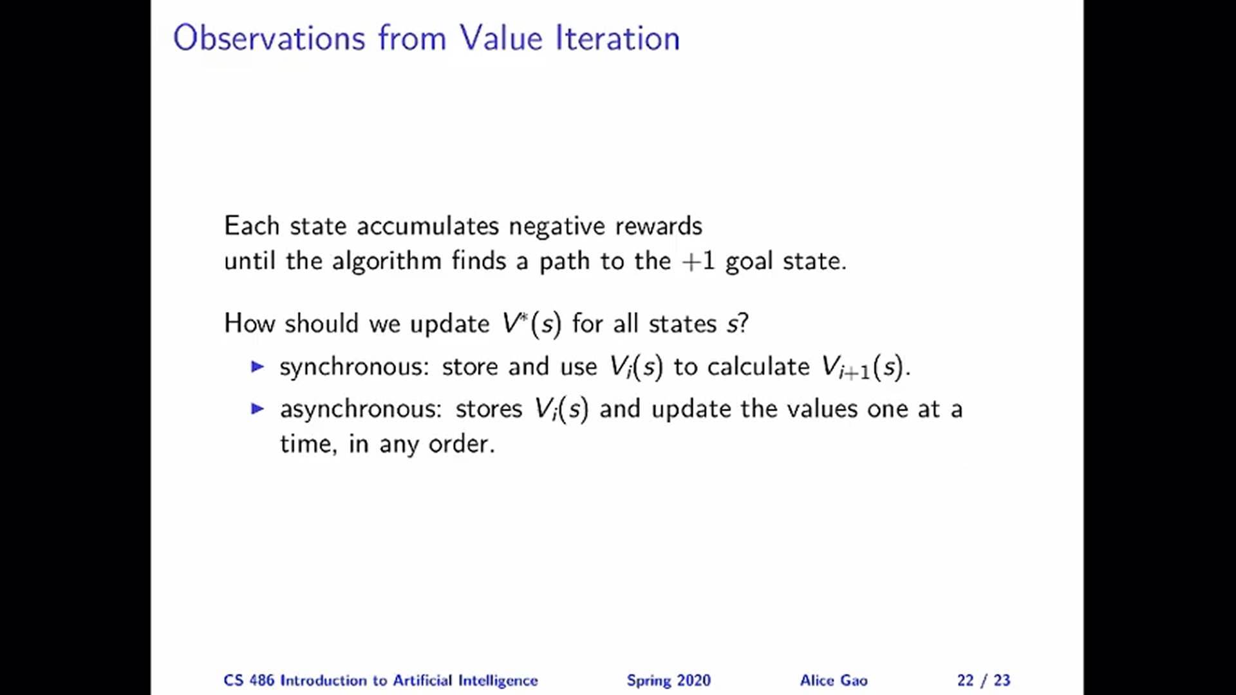

Slide 50


Slide 51
..
Policy Iteration
Deriving the optimal policy does not require accurate estimates of the utility function V*(s)
Policy iteration alternates between two steps
Policy Evaluation- Given a policy $π_{i}$, calculate $V^{π_{i}}(s)$, which is the utility of each state if policy $π_{i}$ was executed
Policy improvement- Calculate a new policy $π_{i+1}$ using $V^{π_{i}}$
Terminates when there is no change in the policy

Slide 52

Policy Iteration
Policy Improvement
$$π_{i+1}\left(s\right)=argmax \sum{P\left(s^{′} | s,a\right) V^{πi}(si)}$$
Policy Evaluation
$$V_{i}\left(s\right)=R\left(s\right)+γ∑P\left(s^{′} | s, π_{i}\left(s\right)\right)V_{i}(s^{′})$$

Slide 53

Policy Iteration v/s Bellman Equations
$$V\left(S_{11}\right)=−0.04+γ(0.8∗V\left(S_{21}\right)+0.1∗V\left(S_{12}\right)+0.1∗V\left(S_{11}\right))$$

Slide 54
Policy Iteration

Slide 55

Policy Iteration

Slide 56
Thank You
Dr. Rajiv Misra, Professor
Dept. of Computer Science & Engg.
Indian Institute of Technology, Patna
rajivm@iitp.ac.in

Slide 58


Slide 59


Slide 60


Slide 61


Slide 62


Slide 63


Slide 64


Slide 65


